Slide 1
Hospitals, Surgeons & Centers, Oh my!
Successful Strategies for selling to this niche group

Slide 2
Speaker Introductions
Shereese Maynard, MS; MBA
@shereesepubhlth
Chief Experience Officer
EnvisionCare Strategies
Staff Policy Writer; Provider Consultant
Chair, Wonderland Health Initiatives
Finalist: C3 Prize 2016:
Breast Cancer Care Plan Applications
2017 National Blockchain Roundtable

Slide 3
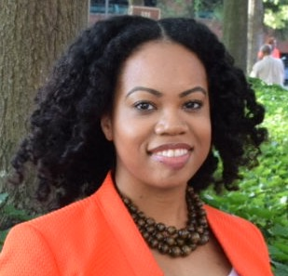
Speaker Introduction
Speaker Introductions
Amelia Roberts, BSN
@RN_solutions
CEO, Solutions By Amelia
Social Media Consultant
Facebook Whisperer
MedStar (WHC) Evidence-based Practice Presenter, 2017
Stanford University MedX “Everyone Included Research Project participant
Care Compliance & Compliance Resource

Slide 4
Sponsorship
@TheStatChat
Stat Chat generously donated the give-away for today’s presentation
There are no conflicts of interest to report

Slide 5
Agenda
Current state of HIT
Who is in this niche group?
How to find what sells
Where/how to engage
The importance of growing your provider community
From contact to conversion

Slide 6
Objectives
Define IDN, ACO, and GPO facilities.
Identify where to find actionable data on hospitals, surgeons, and surgical centers,
Social Selling/Social Listening
Getting credible proposals in front of the right people, to include the surgeons themselves.

Slide 7
CURRENT STATE OF THE HEALTHIT MARKET
ACA (Obamacare)-Not perfect but here for now
Penalties at all time highs (over ½ billion dollars expected for 2017)
Savvy Patients
Finally a push for preventive health
Emphasis on continued quality assurance from regulators and consumers
Notes:
With AHCA defeated, ACA is law of the land and with it HIT initiatives will evolve. Value-based purchasing and consolidations are impacting the market. Telehealth and wearables are looking for buy-in from preventive health attention.

Slide 8
Who is this group?
Surgeons
Hospitals & Surgi-centers
Greater decision-making authority
Self-interest
Looking for the next big thing
Consolidations
Tight capital budgets
Empty beds

Slide 9
IDNs, ACOs, GPOs
IDN: Integrated Delivery Networks
ACO- Accountable Care Organizations
GPO-Group Purchasing Organization
Notes:
Horizontal Integration: Multi-hospital systems. Vertical Integration: cradle to grave (prenatal to hospice). Strategic Integration: high IT purchasing (great opportunity).

Slide 10
RFPs=Request for proposals, State hospital competitive bidding=Competitive Bidding, & CONs = Certificates of Need

Slide 11
How to get Surgeons to Engage : Not so much features and benefits but P+P
Notes:
What does not work is feature and benefit talk. People new to Healthcare often make this rookie mistake. Talk to this group in terms of Patient’s and Payment.

Slide 12
The Buyer’s journey
Why should I come on your journey?
Notes:
Why should I come on your journey…. So the journey is supposed to be about who? The buyer...yet due to our healthcare culture, we do not automatically think marketers have our best interest in mind. We have the snake oil salesman to that for that.

Slide 13
The Buyer’s journey
Who is already at the party?
Notes:
Who is already at the party?Who is already at the party? When we go to your website, we scroll straight to the bottom to see your partners, we want to see people we recognize, if not even people who impress us. Publish or Die is what they know, where have you published? Have you gotten placements in a Trade Magazine or widely read industry newsletter or are you connected to them through their Association?...The Trade Magazine, Industry Newsletter and Association all need to feed the content beast too, guest blog or podcast outreach. how are you Consider having a partnership program ( referral program)

Slide 14
The Buyer’s journey Who will unpack my bags?
Notes:
Surgeons are busy people. By applying the recommendations, you are in with their Association, you did your market research and know their favorite causes/activities you are part of your local corporate volunteer council. You have a face to face meeting about how you will make their life easier. I want to share a story Patient satisfaction intervention...that follows the “patient and payment talk”. There was a person who had an intervention that directly improved patient satisfaction. It is literally plug and play. No training needed. The Objection from the hospital’s, it will be too hard to implement. Tell them how you will make implementation, not something they will worry about, how you will be there after the go-live, how your trainers will ALL teach the SAME way so that when we call in for a question you are not confused about how we got to our problem.

Slide 15
How to find buyers
Find the fishing well or BE the well
CE Provider
Caution about list rental (landing page always)
Conference Vetted( Not all conferences are HITMC) Association Speaker (Partners)
Know where you stand ( where are your toes?)
Notes:
Fishing well is a term used to find out where people gather. There is that OR you can BE the well

Slide 16
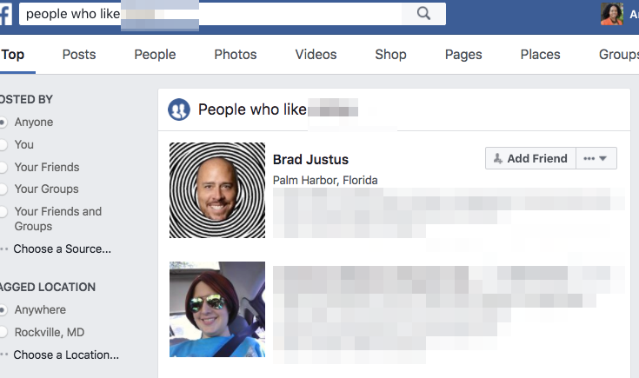
How to find buyers: Social Phishing is not just for hackers
Notes:
LinkedIn Strategy, Twitter Strategy, Facebook. These are used by my Generation as a search engine, we don’t do google like that like that. Buyers are Community members. They enjoy organizations and charity offerings. Some will even talk about that mission trip they are looking forward to, they may be listed on the testimonial page of a local group ( everyone like to talk about that doctor they know). I’m part of a local Business Networking Group, we have a few independent practice owner providers who are members. Same with Conference vetting, using what is being said about these organizations, selecting a meeting or two could be helpful. What can you offer in addition to your service offering? CE Provider? Business support?

Slide 17
Integrated Marketing Strategy
A Twitter List as a CRM System?
Notes from the Financial World
Make life easier for all( Demo- Scheduling)
Notes:
Pre conference warm up. Twitterchats, Twitter Lists. Online + Offline Connections. Intro SM

Slide 18
Why knowledge of Supply chain mgt is vital
Understanding stakeholder needs
Understanding how purchases are made.
Understanding how your products/services fit into the mix
Notes:
Healthcare supply chain management involves obtaining resources, managing supplies, and delivering goods and supplies to providers and patients

Slide 19
Event-driven targeting
Elevating the Conversation
Preparation
Solution Selling
Relationship building across hospital systems

Slide 20
Building a community of providers
Leverage data to understand the surgeons and hospitals with whom you’re engaging
Engage a K.I.S.S strategy when contacting your target community
Use technology to manage contact and to follow-up.

Slide 21
Q & A
Thanks
Amelia Roberts, RN @rn_solutions
StatChat @thestatchat
John Lynn @techguy
Drawing for giveaway!

