Slide 1
Marketing in the Realm of the BOLD
HITMC 2015
Christine Slocumb

Slide 4
If you don't let your marketing team be proud and a bit "out there”…
then you might as well fire them.

Slide 5
"We're a humble organization, but as marketers you can't be humble.”
Renee Richardson, Caterpillar
Notes:
Read the story “No More Boring Brands” in Chief Content Officer Magazine
http://contentmarketinginstitute.com/2014/11/no-more-boring-brands-creative-content/

Slide 6
Ways You Can Be BOLD

Slide 7
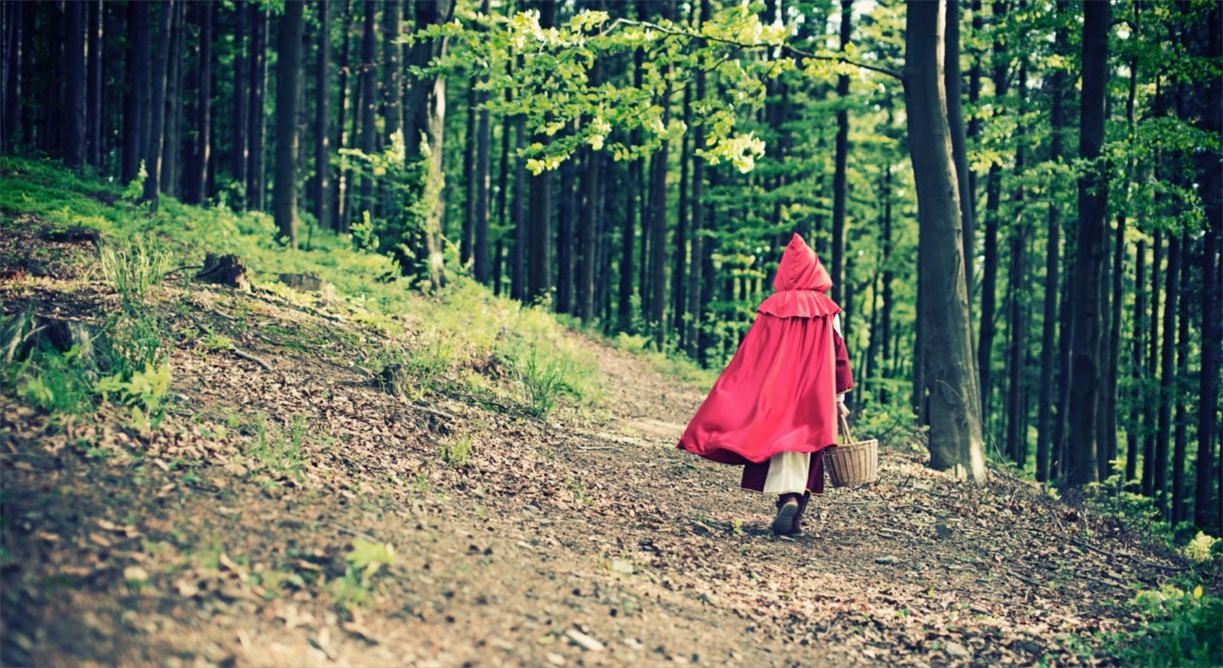
Be a storyteller

Slide 8
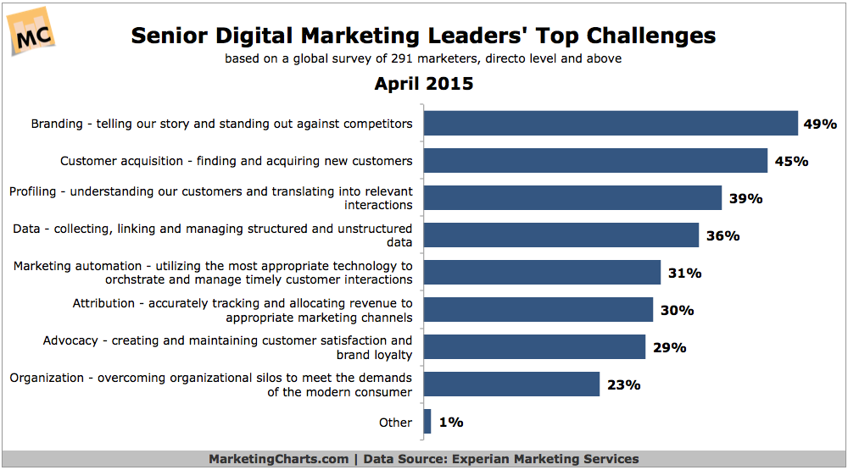
r

Slide 9
“…people will forget what you said, people will forget what you did, but people will never forget how you made them feel.”
- Maya Angelou

Slide 10
Challenge the Status Quo

Slide 11
Use Humor

Slide 12
Feature Your Customers

Slide 13
Be Different

Slide 15
Have fun

Slide 16
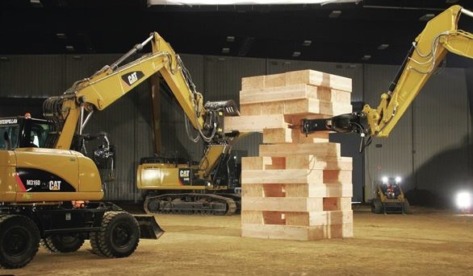
Notes:
Caterpillar filmed JENGA game using it’s equipment as part of its “Built for It” campaign.

Slide 18
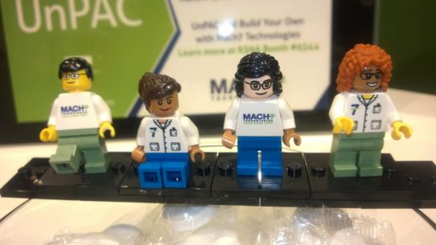

Slide 19
Focus
If you could only use one marketing channel to reach your customer, which would it be?
Notes:
From post http://mediashower.com/blog/improve-your-marketing-focus-in-10-minutes/
You have a limited supply of energy.
You have a limited supply of attention.
You have a limited supply of time, and money, and resources.
Focus it on what matters.

Slide 20
Experiment with a new channel

Slide 21
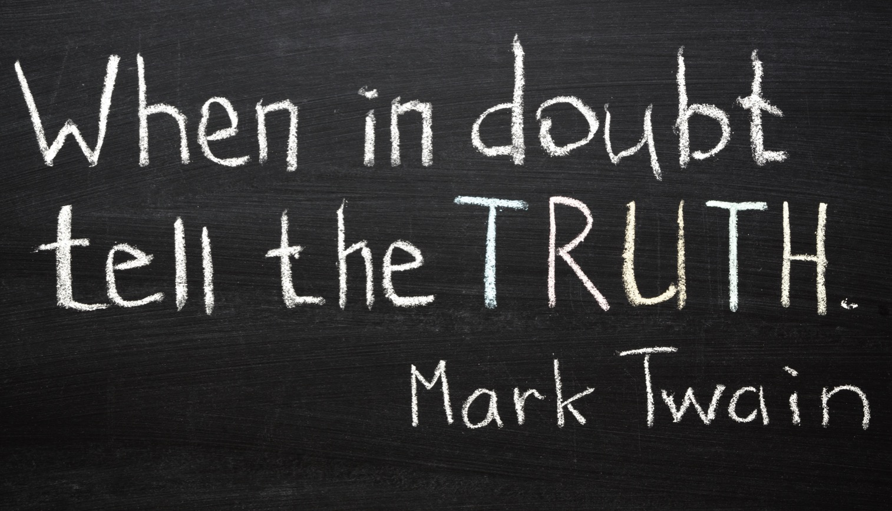
Notes:
Be True. Be Honest.

Slide 22
Getting Out of Creative Ruts

Slide 23
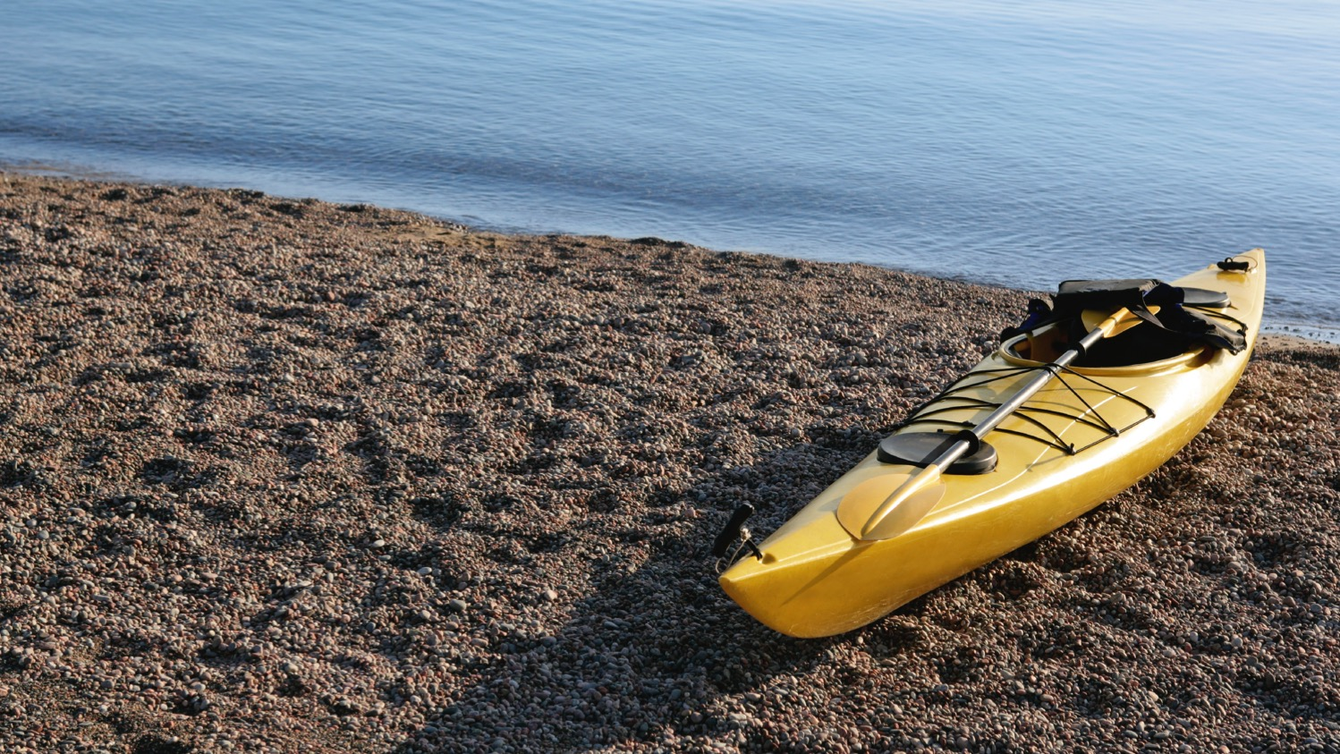
Get out (of your office)
Notes:
Reference “Steal Like an Artist” Chris kayak photo on iPHone camera roll

Slide 24
Read

Slide 25
Read

Slide 26
Getting Buy-In For BOLD

Slide 27
One of your goals in marketing should be to make your C-level at least a little uncomfortable…
(in a good way)
Notes:
Find squirm stock photo.

Slide 28
Share BOLD Success Stories
Notes:
Winning award stock photo

Slide 29
Show How Your Competition is BOLD
Notes:
Bumjee jump stock photo

Slide 30
Tap into Naysayers’ Interests
Notes:
Skiing or photographer photo

Slide 31
Enlist a Thought Leader
Notes:
Physician photo

Slide 32
Find An (Unlikely) Champion
Notes:
Find the person in the org from outside healthcare.

Slide 33
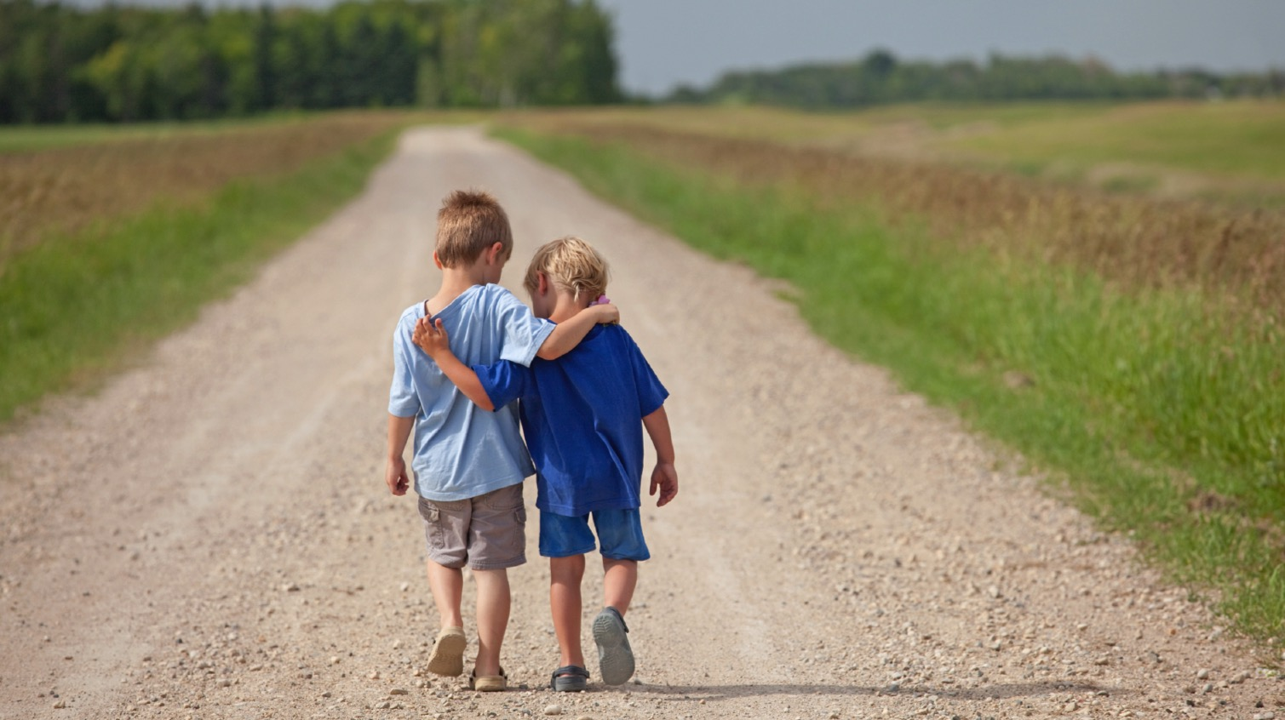
Make a friend in Legal

Slide 34
YOU HAVE THE POWER TO
GROW YOUR COMANY

Slide 35
Blog: clarityqst.com/blog
Twitter: @CSlocumb
Thank you!

