Slide 1
EVENTS! They’re all fun and games…
@stacygoebel #HITMC

Slide 2
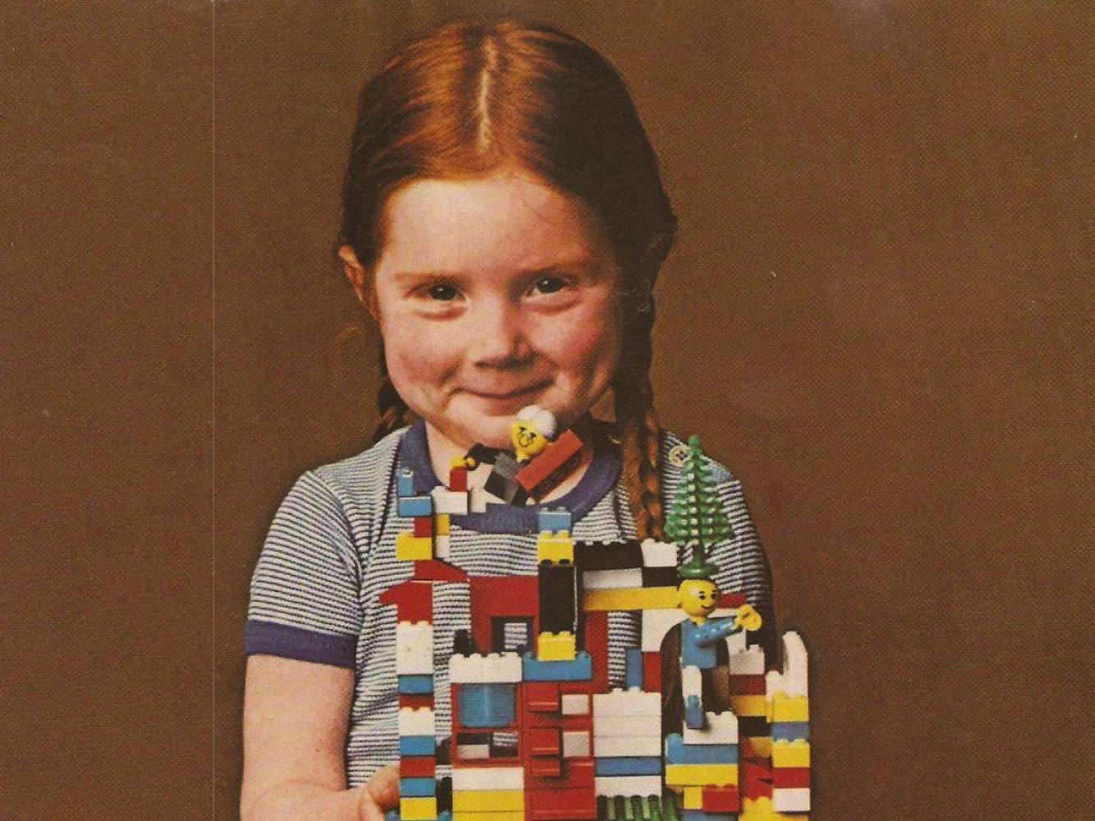

Slide 3
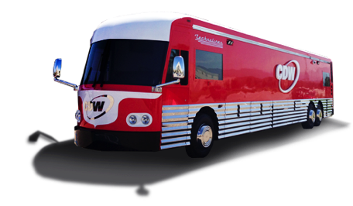
TIPS FOR CREATING MEMORABLE TRADESHOW EXPERIENCES
5

Slide 4
Know your WHY
#1
@stacygoebel #HITMC

Slide 5
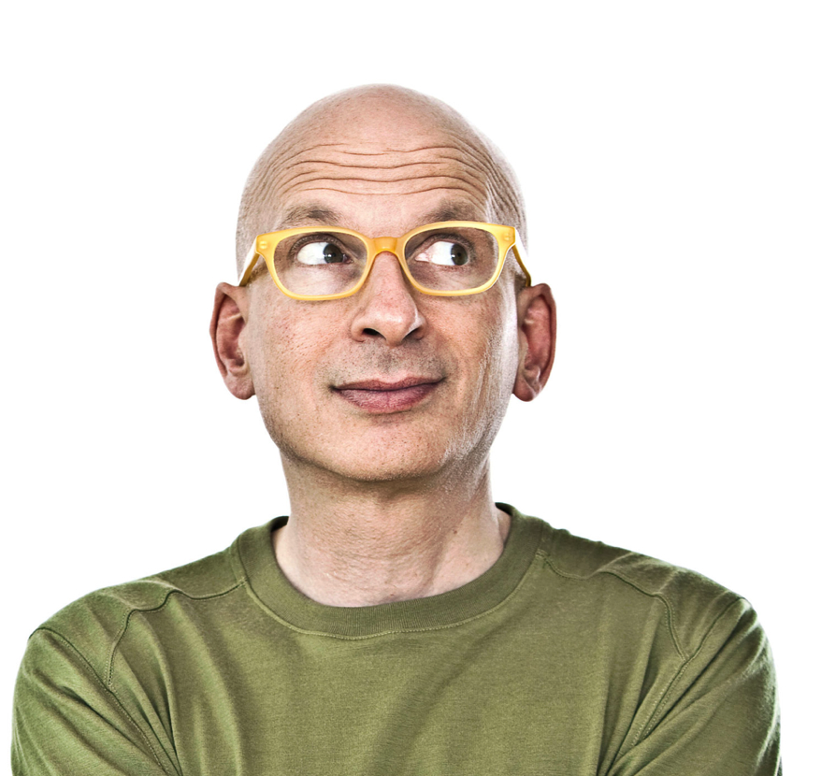
Create things
that matter.
Seth Godin

Slide 6
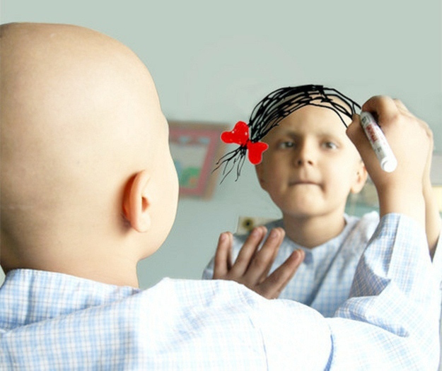

Slide 7
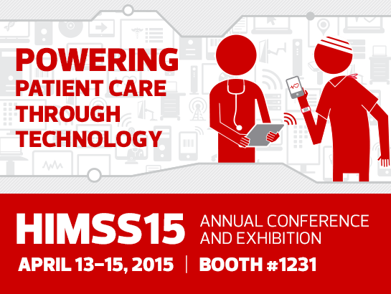

Slide 8
HIMSS15 GOALS
Generate leads
2,000 leads
Nurture existing customer relationships
100 meetings, 300 customers at event
Boost awareness of brand, solutions, services and expertise
5000 station scans
Continue to elevate position as a thought leader
10,000 social engagements, 400 @mentions

Slide 9
Know Your Customer’s Why
#2
@stacygoebel #HITMC

Slide 10
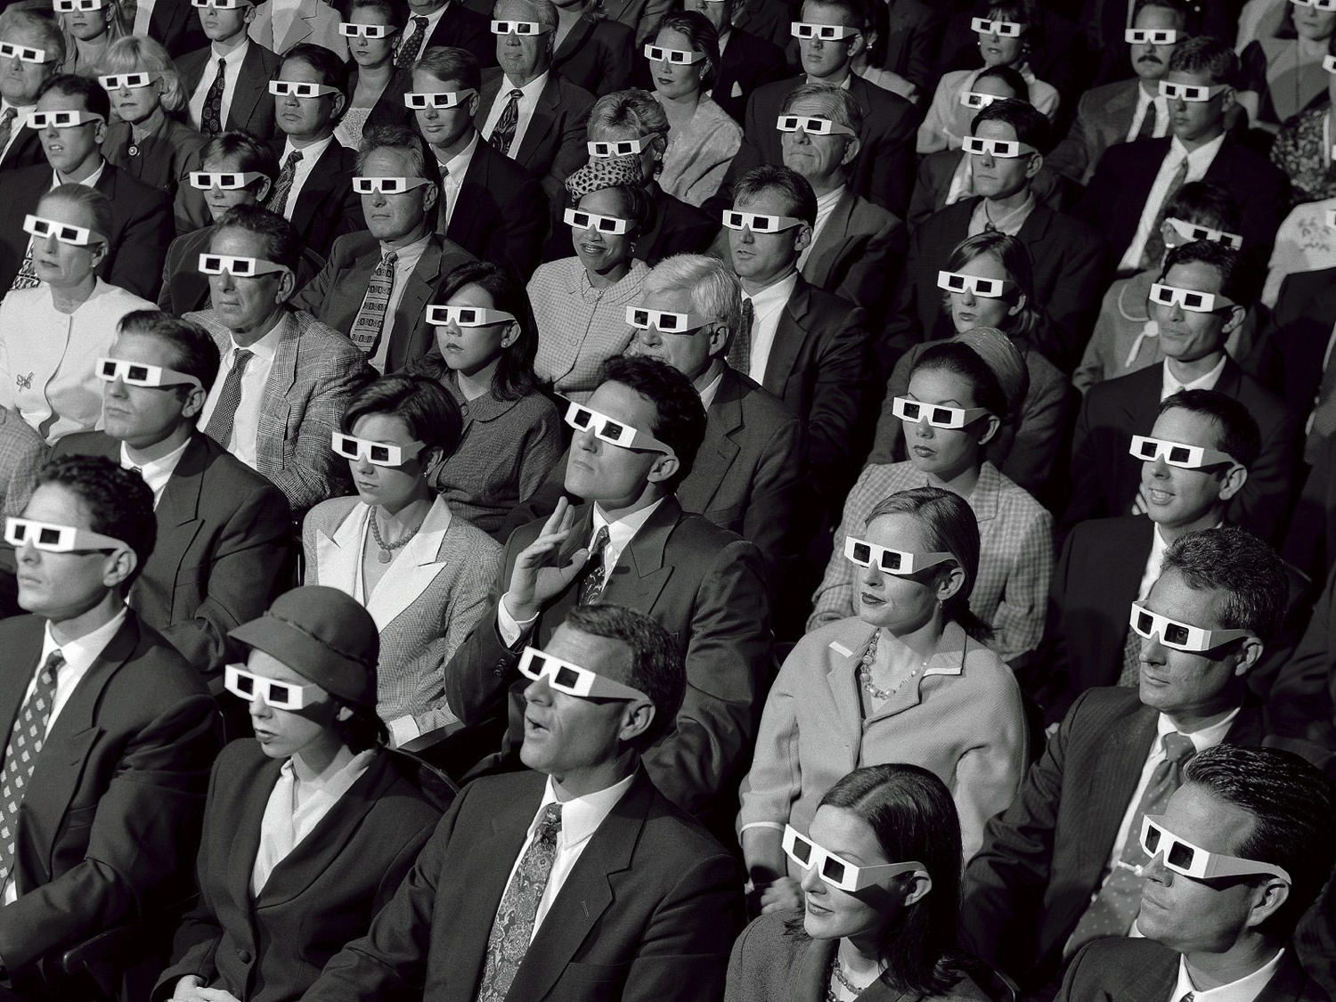

Slide 11
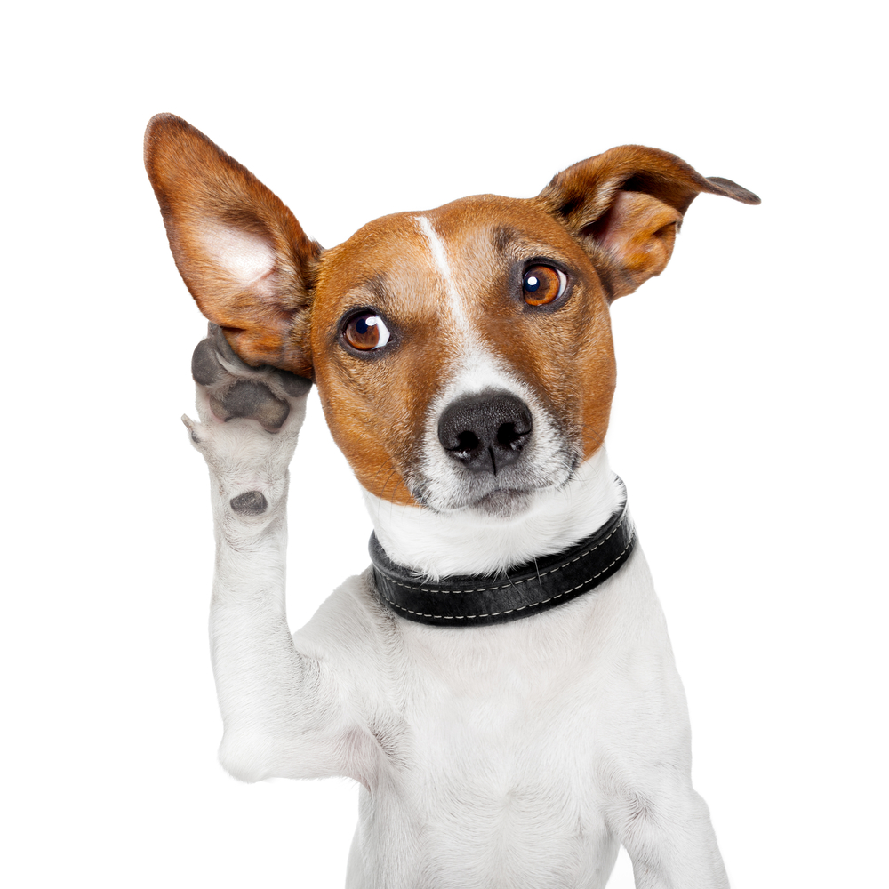

Slide 12
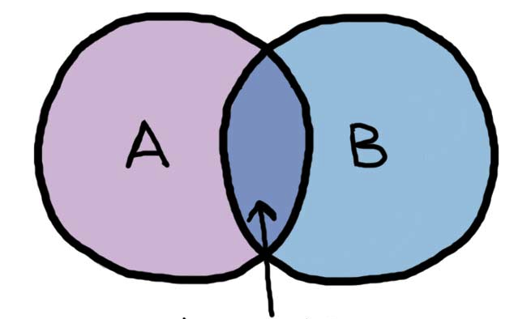

Slide 14
BUILD ON PAST SUCCESSES
#3
@stacygoebel #HITMC

Slide 15
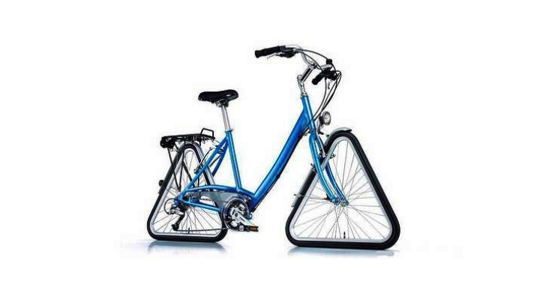

Slide 16
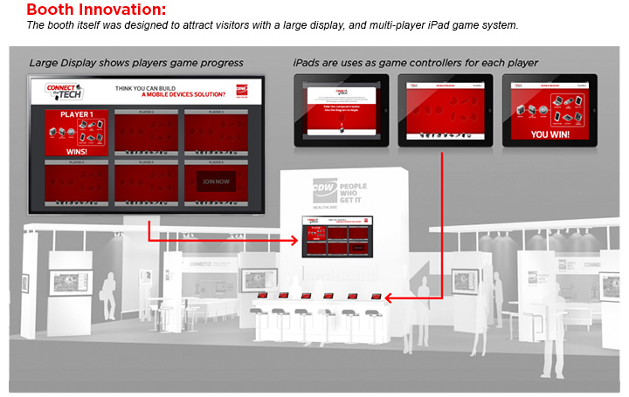
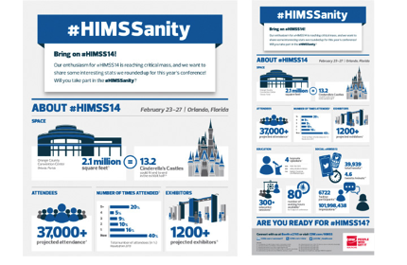
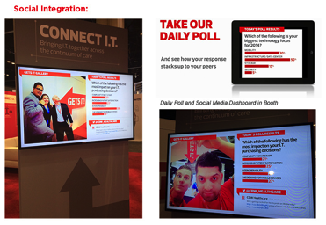

Slide 17
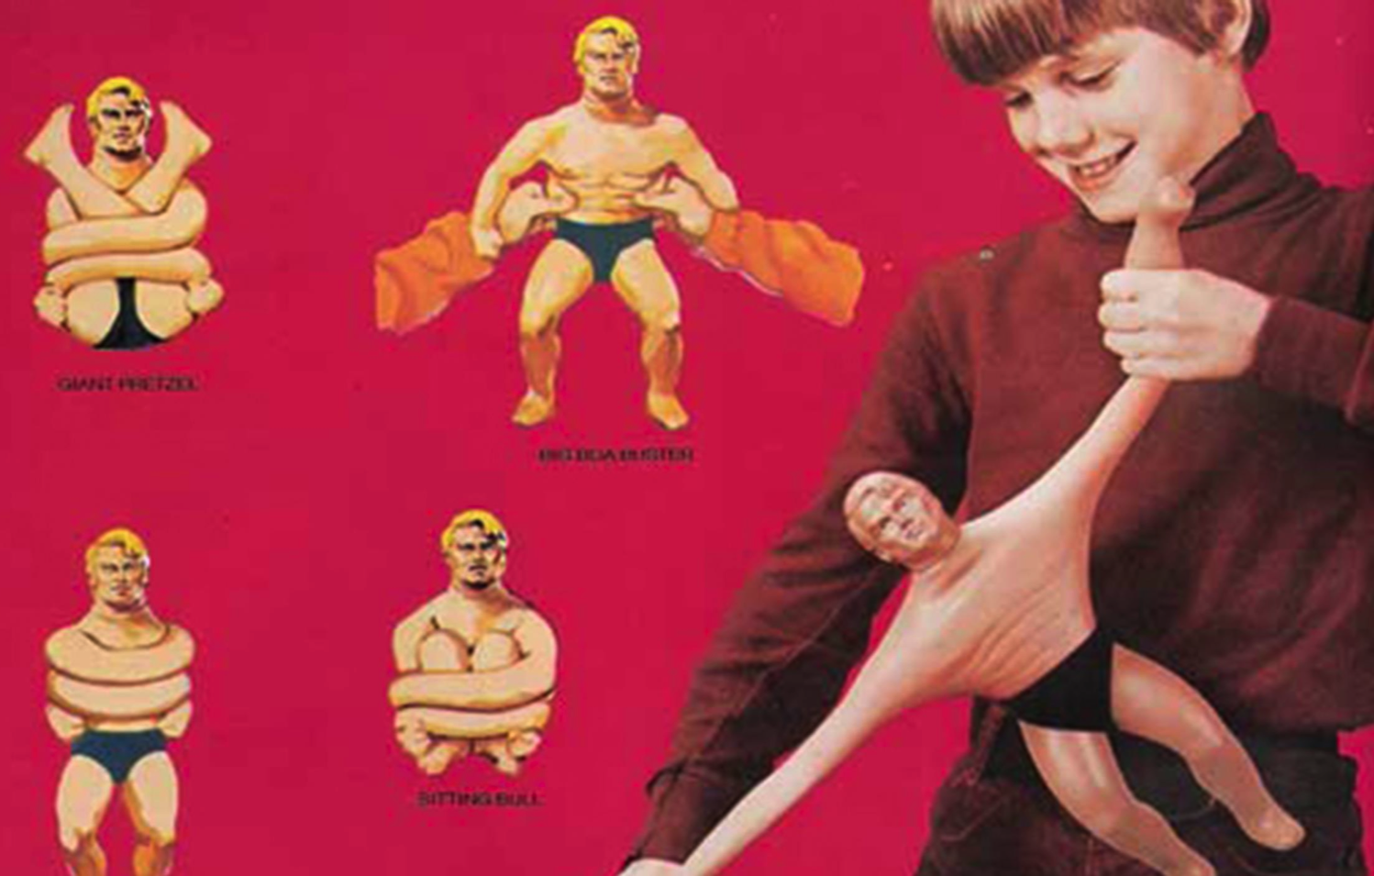

Slide 19
CREATE A LASTING IMPRESSION
#4
@stacygoebel #HITMC

Slide 20
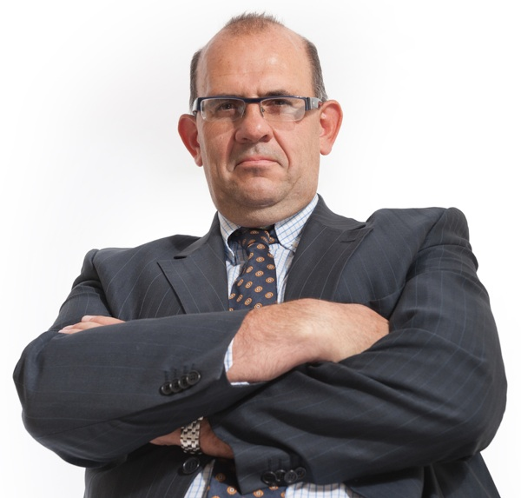

Slide 21
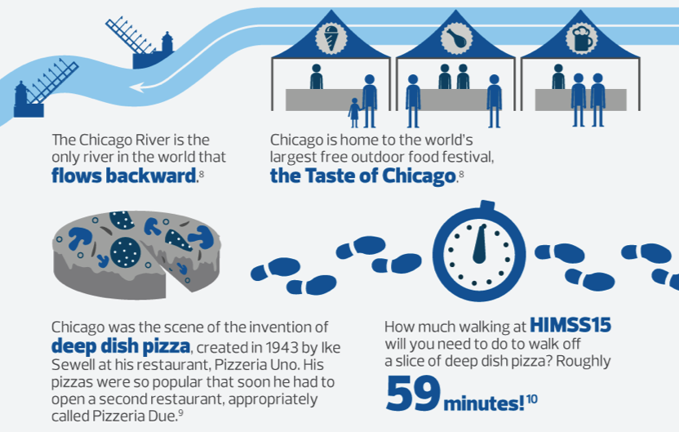

Slide 22
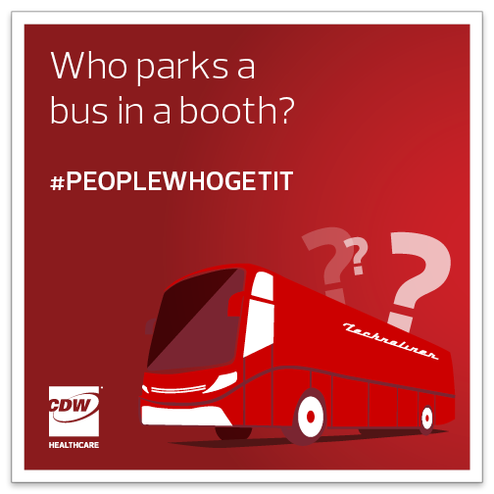
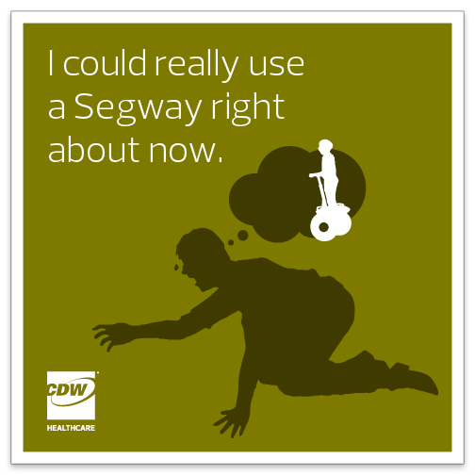
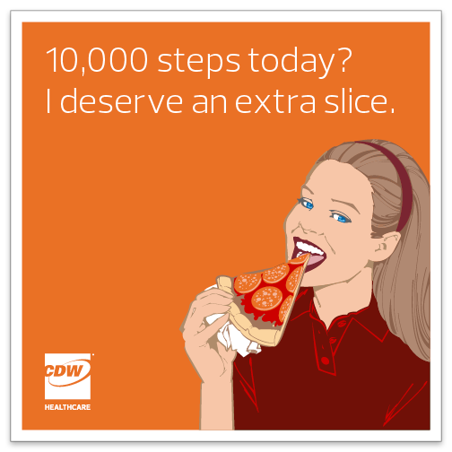

Slide 23
DO SIMPLE THINGS FOR
THE GREATER GOOD.
This fun brought to you by

Slide 24
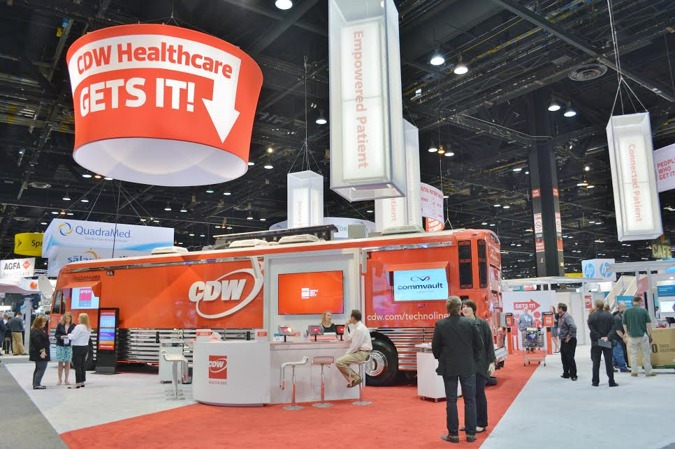

Slide 25
SCAN IT BANDS (RFID TECHNOLOGY)

Slide 26
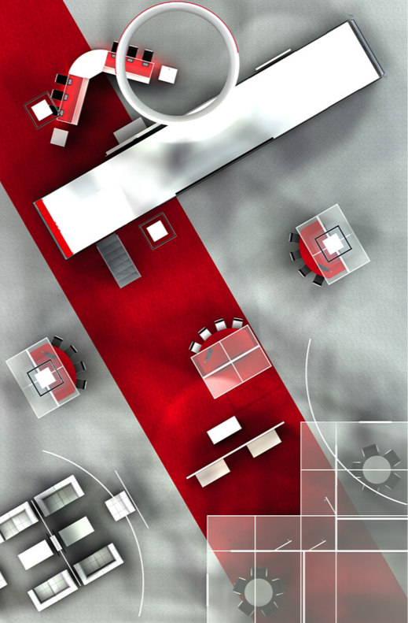
EMPOWERED PATIENT
MOBILE PATIENT
CONNECTED PATIENT
SECURE PATIENT

Slide 27
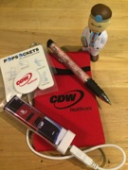
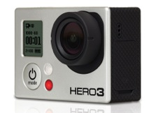

Slide 28
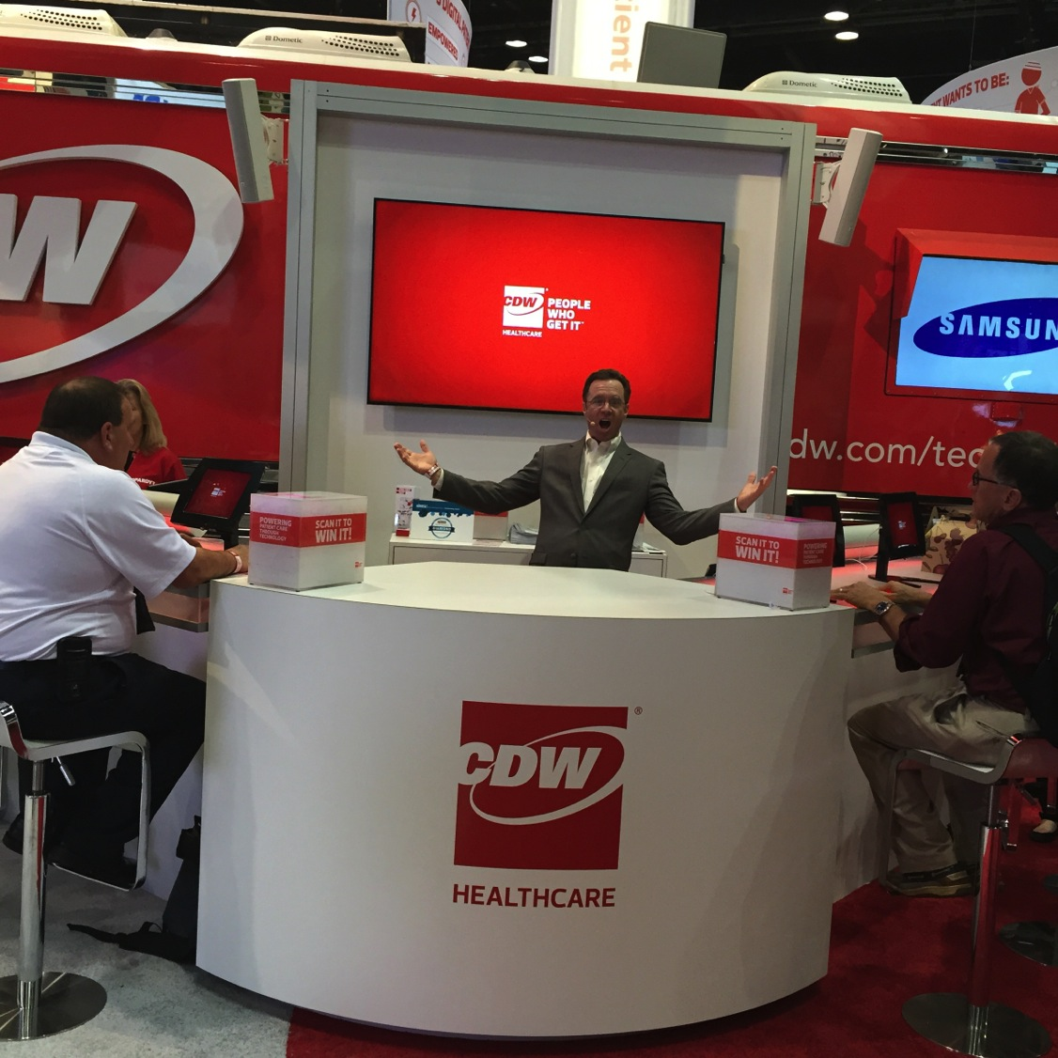

Slide 29
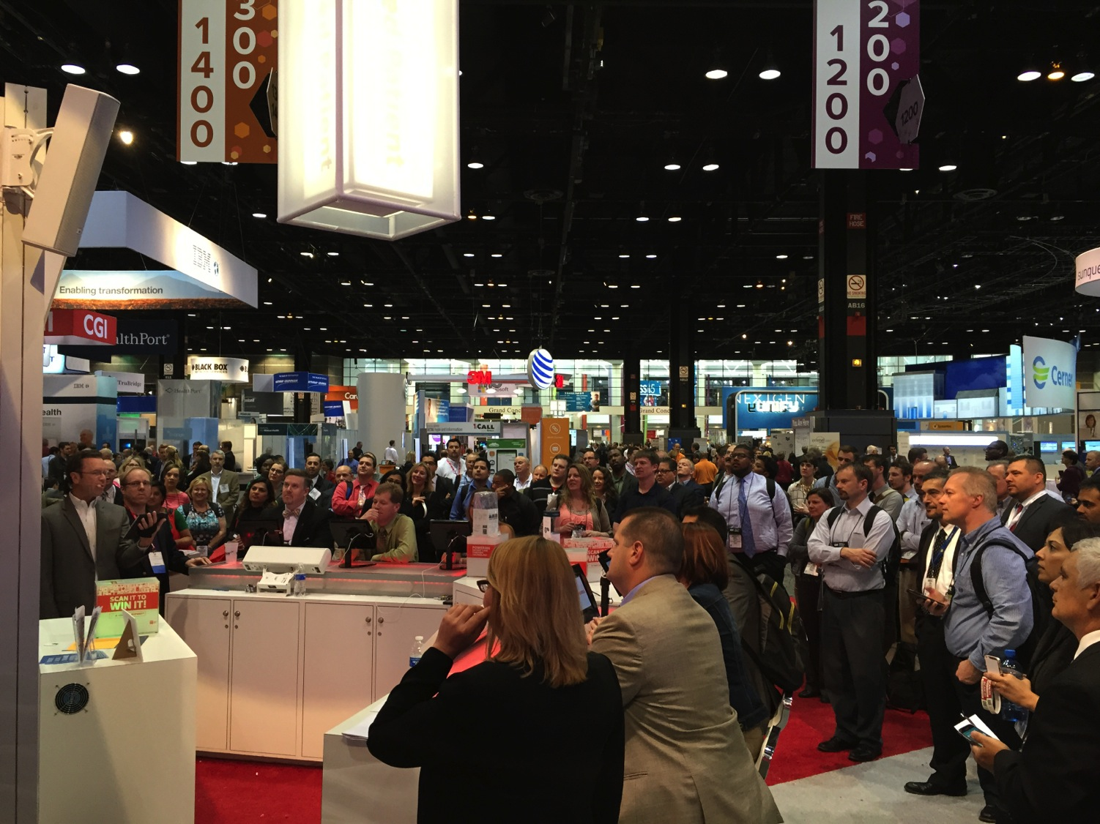

Slide 30
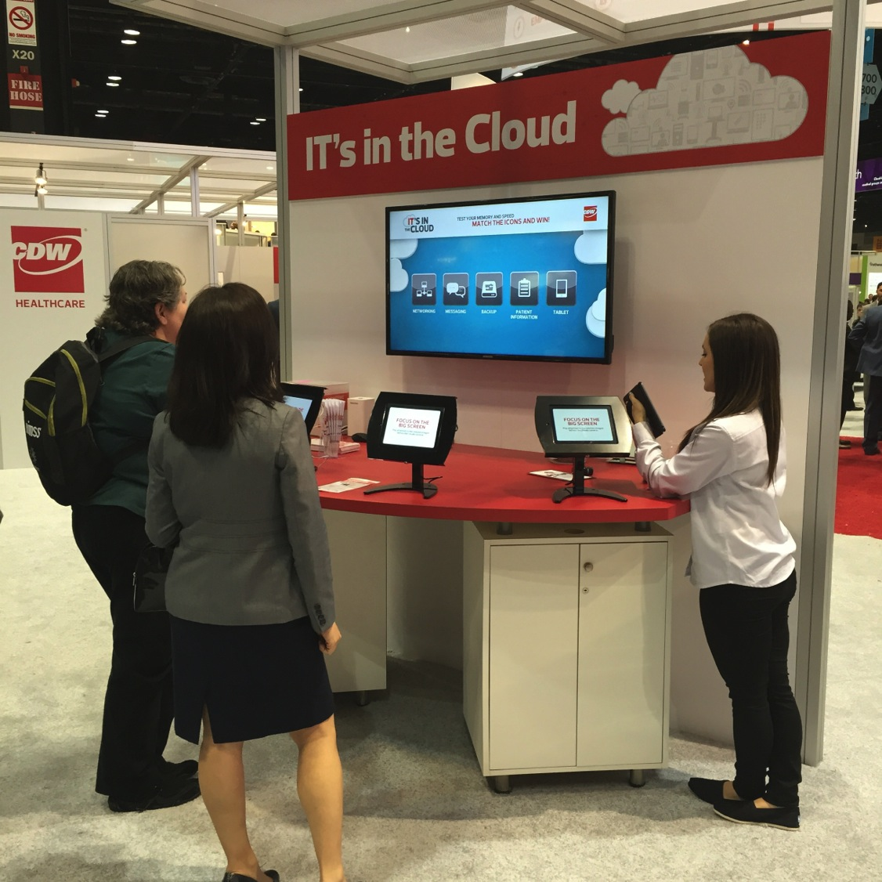

Slide 31
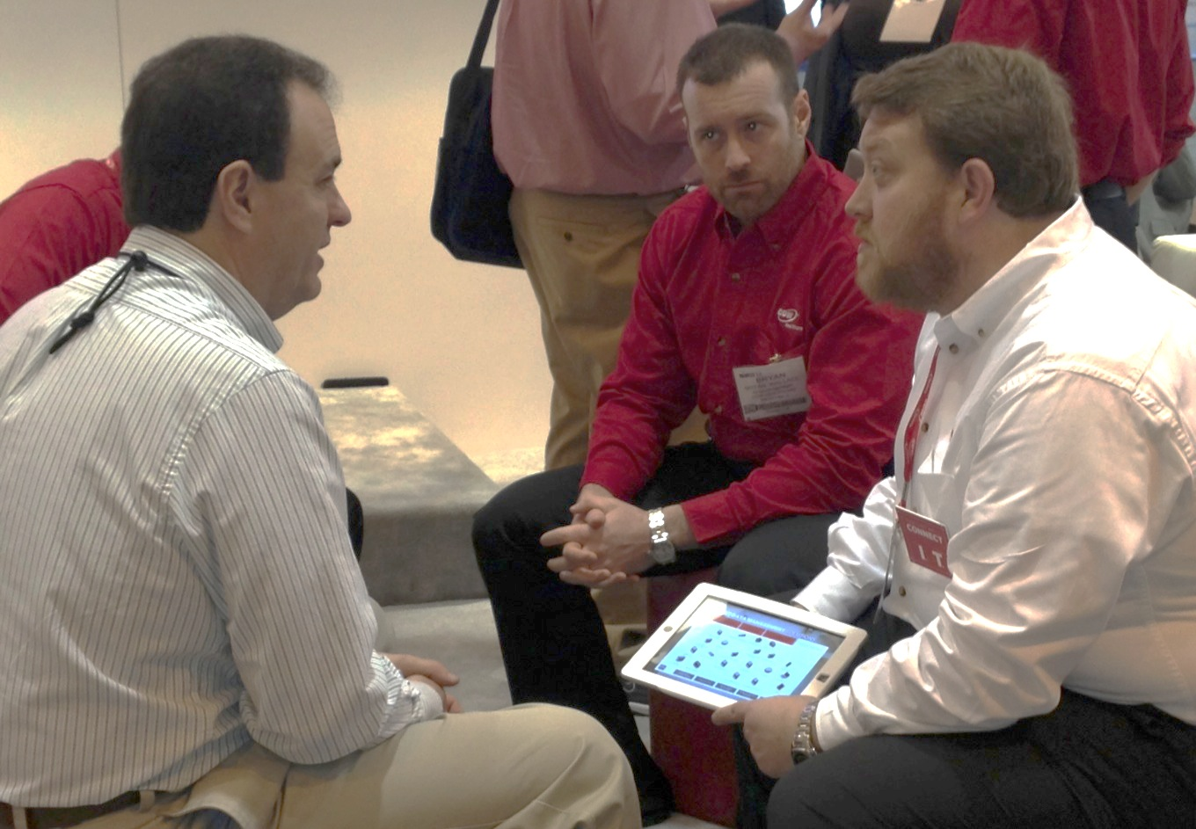

Slide 32
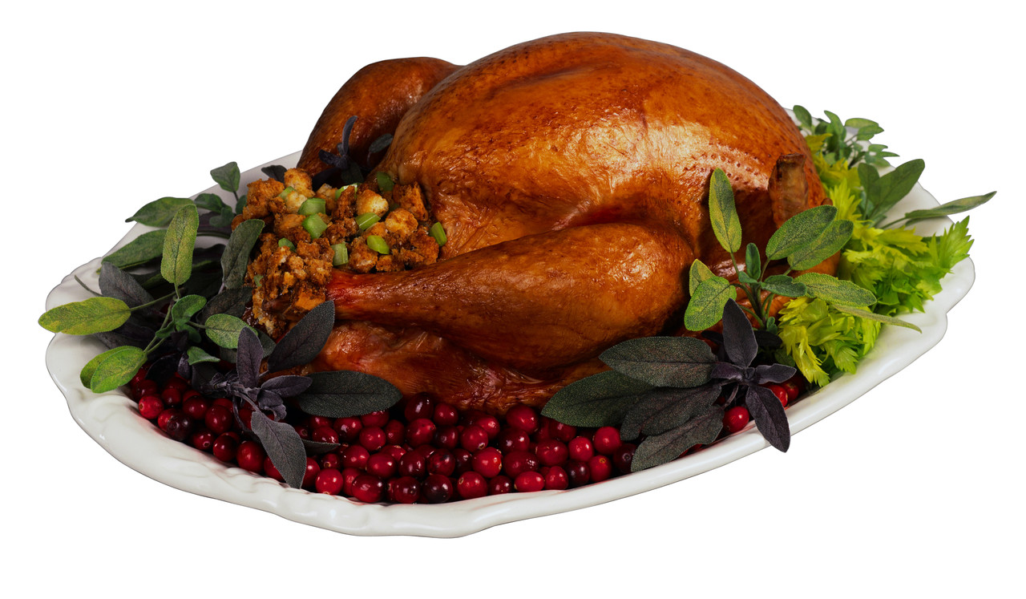

Slide 34
IT takes a village (and a village planner)
#5
@stacygoebel #HITMC

Slide 35
10 MONTHS OUT
FOLLOW
THROUGH
PLAN
IMPLEMENT
Kickoff
Research
Training
Debrief
Review
Concepts
Follow-up
Celebrate
Experience
Metrics Plan
Start Over
Environment
Design & Build
TRADESHOW
Objectives & Goals
Communication Plan
Team Coordination
Preshow Communication

Slide 36
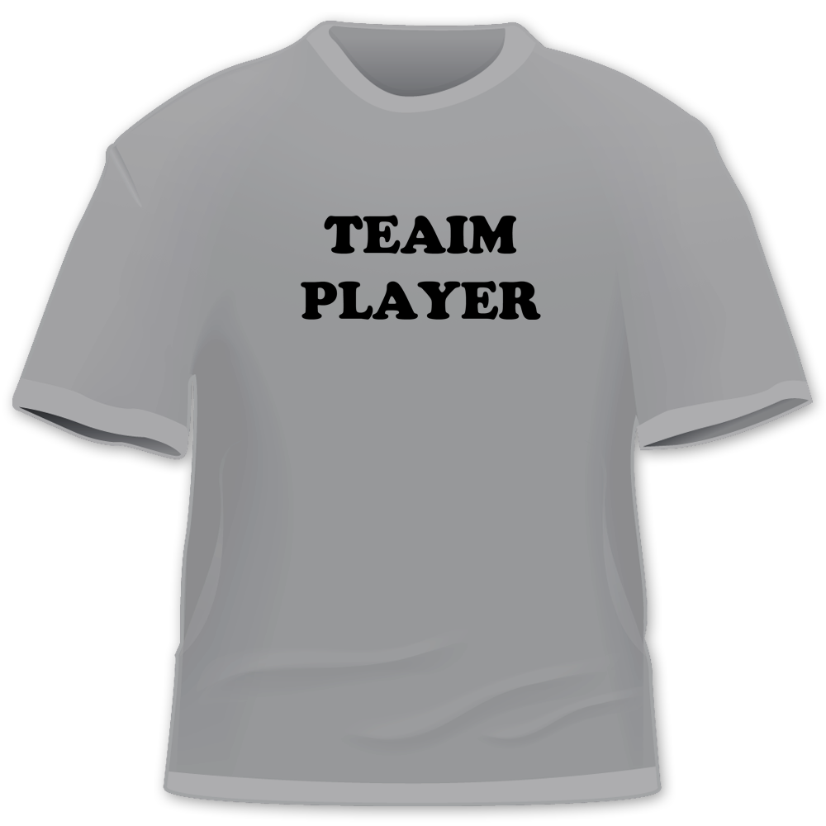

Slide 37
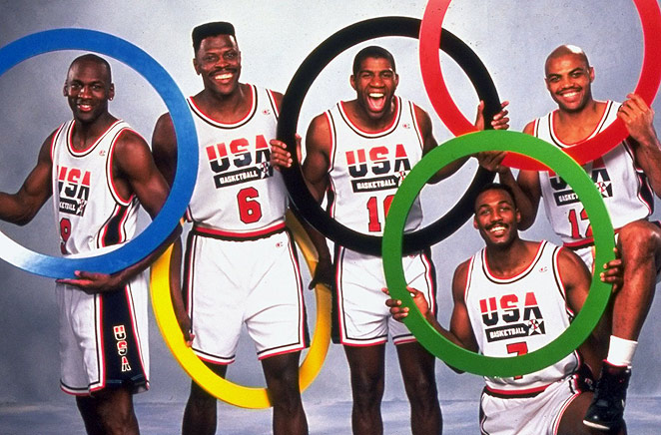

Slide 38
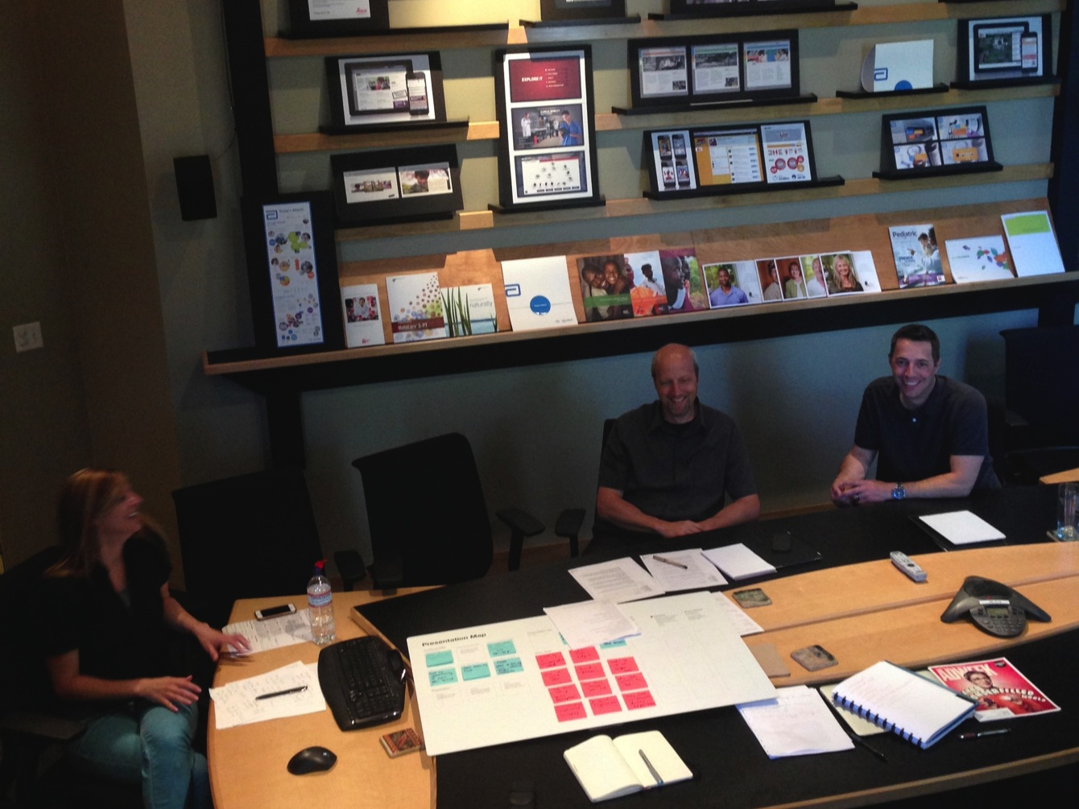

Slide 39
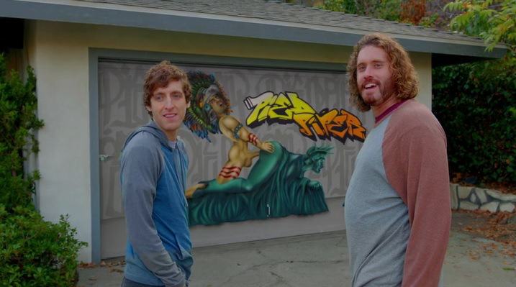

Slide 40
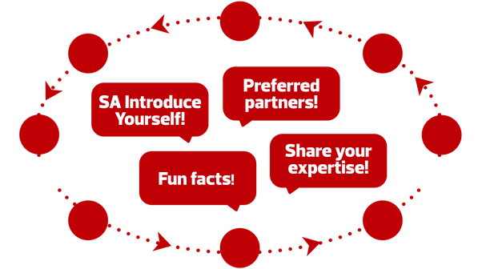
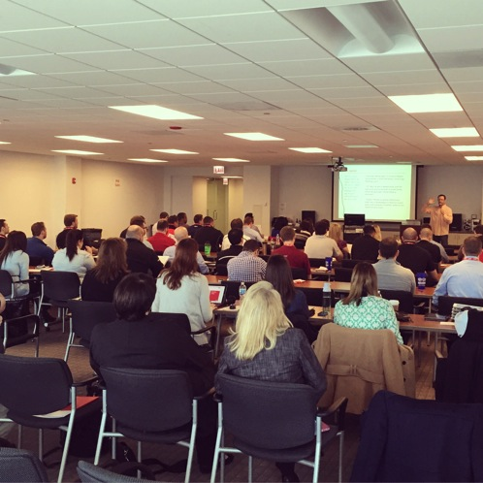
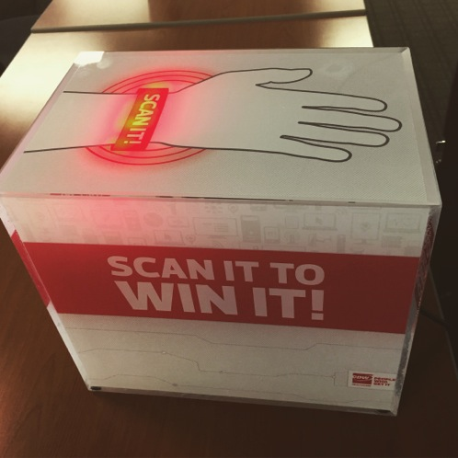
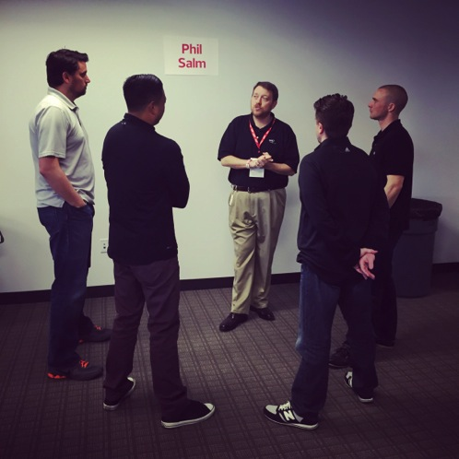
SPEED GREETING

Slide 41
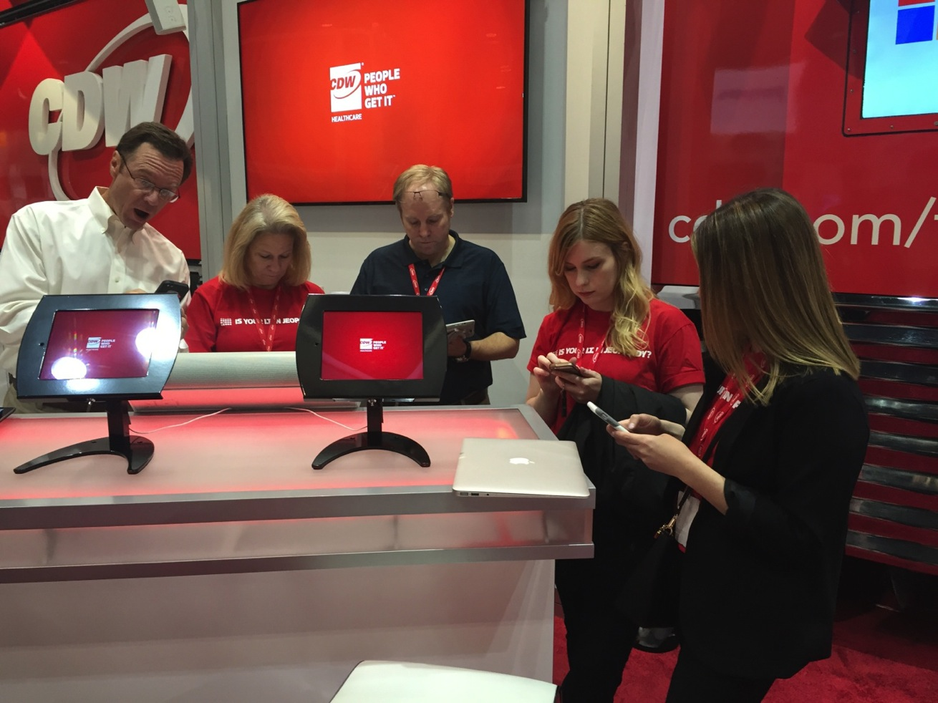

Slide 42
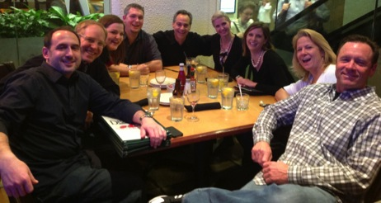
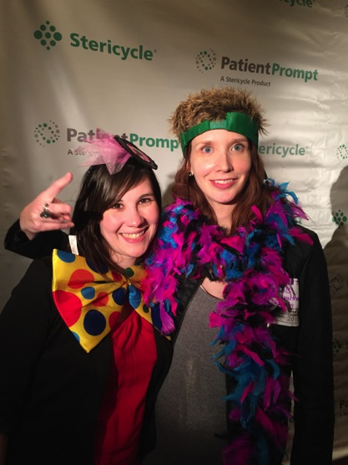
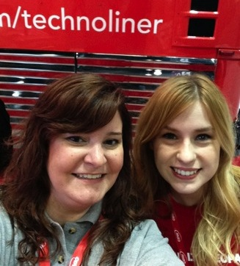
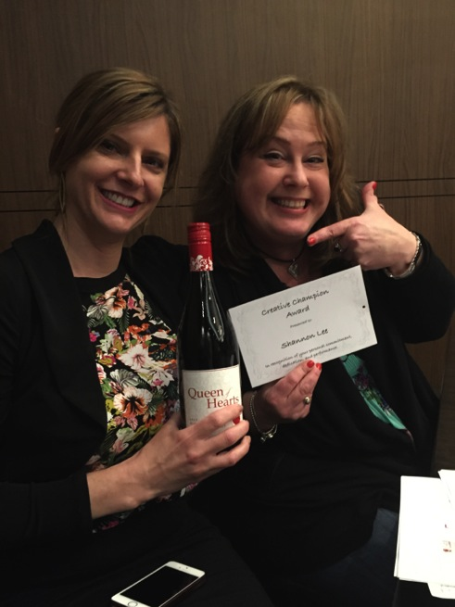
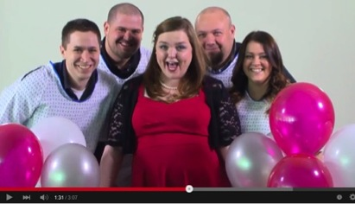
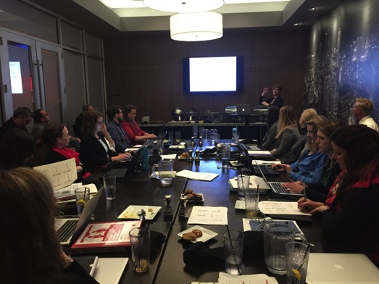
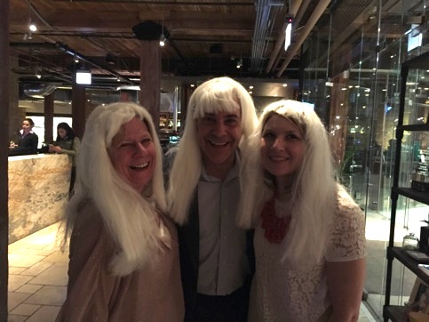
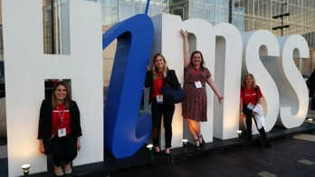

Slide 43
TIPS FOR CREATING MEMORABLE TRADESHOW EXPERIENCES
#1
Know Your Why
#2
Know Your Customer’s Why
#3
Build on Past Successes
#4
Create a Lasting Impression
#5
It Takes a Village
@stacygoebel #HITMC

Slide 44
