Slide 1
Content marketing? Let’s Talk content Strategy, First
Sarah Davelaar
Digital Health Content Strategist
The Signal Center for Health Innovation

Slide 2
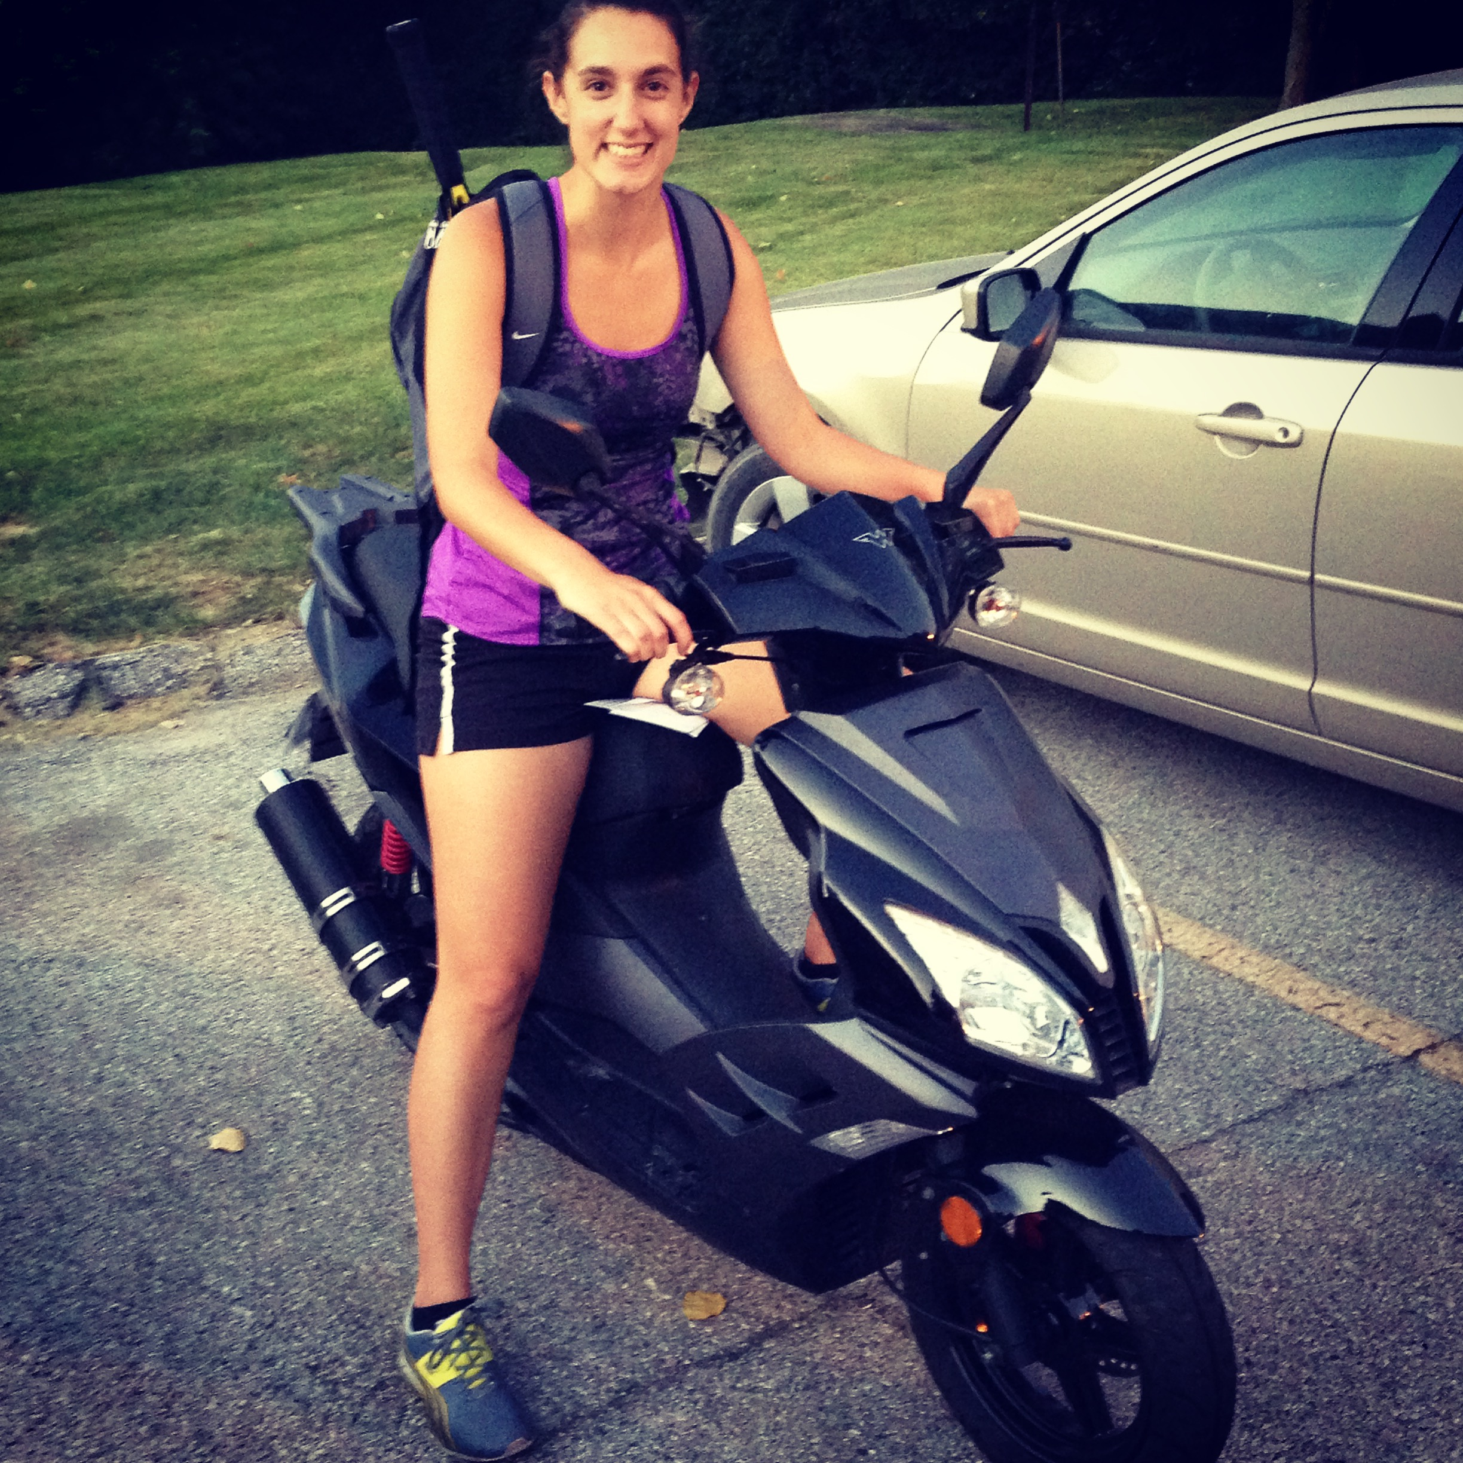
About Sarah
Pittsburgh → Sioux Falls → Vermillion →
Des Moines → Iowa City
Waynesburg University – BA
University of South Dakota – MBA
@SarahDavelaar | #HITMC

Slide 4
Content strategy
What is it?
Why does it matter?
How to document it?
@SarahDavelaar | #HITMC

Slide 5
Content is king.
Bill Gates
January 3, 1996
Source: http://web.archive.org/web/20010126005200/http:/www.microsoft.com/billgates/columns/1996essay/essay960103.asp
@SarahDavelaar | #HITMC

Slide 7
“Opportunities are remarkable, and many companies are laying plans to create content for the Internet.”
-Bill Gates

Slide 8
It’s Crowded
Today*
3,154,096+ blog posts written
429,302,744+ tweets sent
3,467,150,000+ Google searches
@SarahDavelaar | #HITMC
*Source: www.worldometers.info – data taken at 3:45 p.m. on March 28, 2017

Slide 9
ACTIVITY ≠ PRODUCTIVITY
ASK: What is winning in this equation?
@SarahDavelaar | #HITMC

Slide 10
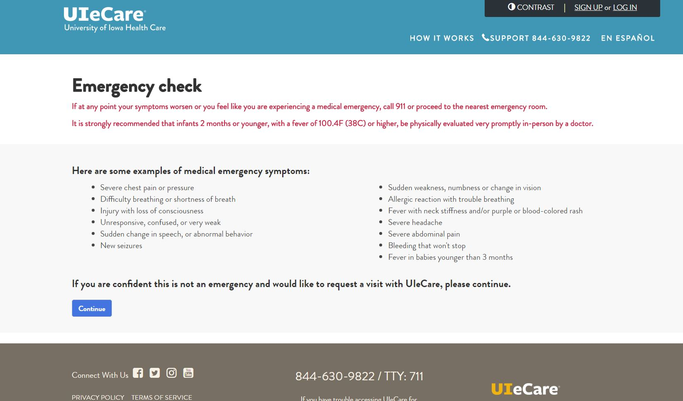

Slide 12
Those with a documented content marketing strategy:
Are far more likely to consider themselves effective at content marketing
Feel significantly less challenged with every aspect of content marketing
Consider themselves more effective in their use of all content marketing tactics and social media channels
Were able to justify spending a higher percentage of their marketing budget on content marketing
@SarahDavelaar | #HITMC

Slide 13
75% of the most effective teams document their strategy
@SarahDavelaar | #HITMC

Slide 15
LACK OF STRATEGY = NO IMPACT
@SarahDavelaar | #HITMC

Slide 16
So, what exactly is content strategy?
@SarahDavelaar | #HITMC

Slide 17
Content strategy guides planning for the creation, delivery, and governance of useful, usable content.
@SarahDavelaar | #HITMC

Slide 18
At it’s best, content strategy defines:
key themes and messages
recommended topics
content purpose (i.e., how content will bridge the space between audience needs and business requirements)
content gap analysis
metadata frameworks and related content attributes
search engine optimization (SEO)
implications of strategic recommendations on content creation, publication, and governance
Source: Kristina Halvorson https://alistapart.com/article/thedisciplineofcontentstrategy
@SarahDavelaar | #HITMC

Slide 19
“Give me 6 hours to chop down a tree and I will spend the first four sharpening the axe.”
ABRAHAM LINCOLN
@SarahDavelaar | #HITMC

Slide 20
What makes content successful?
It accomplishes what it set out to do…
@SarahDavelaar | #HITMC

Slide 21
“Our job is not to ‘make great content.’ Our job is to make content that accomplishes our organization’s goals.”
Rand Fishkin
@randfish
@SarahDavelaar | #HITMC

Slide 22
“How do your goals/objectives support OKRs, rather than growth
of social networks and email subscribers? Are we increasing margins? The goal is to report
on revenue generated.”
-Andrew Davis
@DrewDavisHere
@SarahDavelaar | #HITMC

Slide 23
“How do your goals/objectives support OKRs, rather than growth of social networks and email subscribers? Are we increasing margins? The goal is to report on revenue generated.”
Andrew Davis
@DrewDavisHere
@SarahDavelaar | #HITMC

Slide 24
Align Org’s Top Priorities to Content
Earn X% more leads for sales team without increasing budget
Identify search queries and create content to rank
Ensure that brand is tied to expertise, quality, and problem-solving disposition
Identify & create content to help audience in our industry
Increase scalability of digital health implementations
Evaluate and utilize new tool to improve content team efficiency
@SarahDavelaar | #HITMC

Slide 25
How you communicate goals matters...
Source: www.dominican.edu/dominicannews/study-highlights-strategies-for-achieving-goals
@SarahDavelaar | #HITMC

Slide 26
@SarahDavelaar | #HITMC

Slide 27
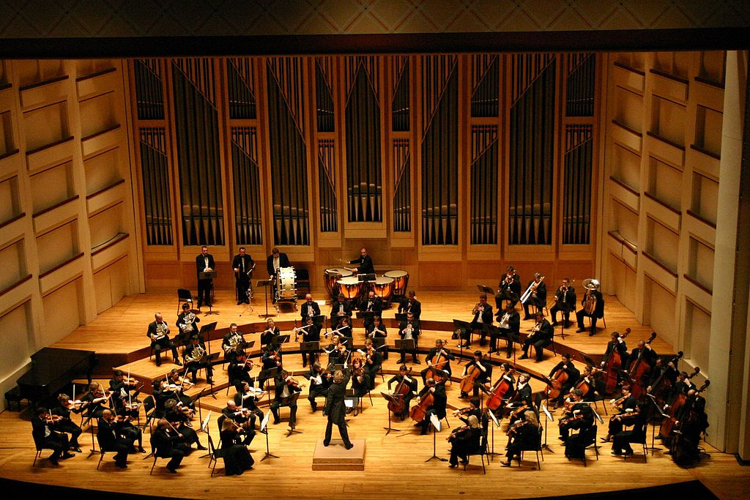
DIGITAL GOVERNANCE
@SarahDavelaar | #HITMC

Slide 28
Decision-Making Primer
RECOMMEND
AGREE
INPUT
DECIDE
PERFORM
Source: https://hbr.org/2006/01/who-has-the-d-how-clear-decision-roles-enhance-organizational-performance
@SarahDavelaar | #HITMC

Slide 29
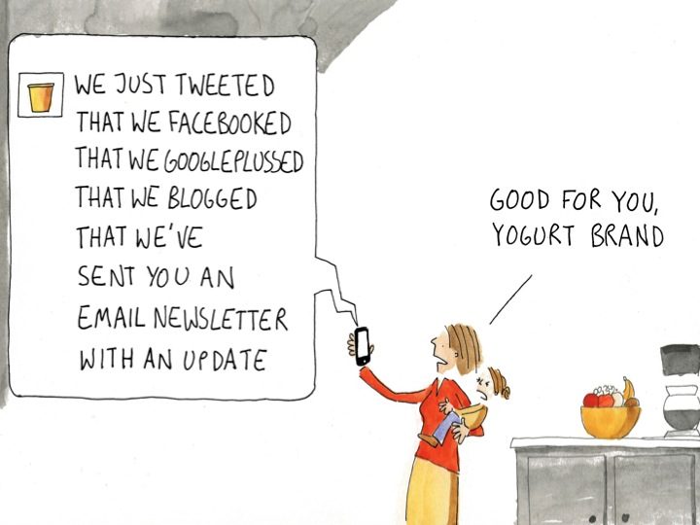

Slide 30
Audit & Repurpose
Create
Once
Publish
Everywhere
@SarahDavelaar | #HITMC

Slide 31
Start with the end in mind.
@SarahDavelaar | #HITMC

Slide 32
“inch by inch, each justifiable (or justified) moment adds up to become a brand, a reputation, a life.”
SETH GODIN
@ThisIsSethsBlog
@SarahDavelaar | #HITMC

Slide 33
Template:
http://bit.ly/contentstrategytemplate

Slide 34
Questions?
@SarahDavelaar | #HITMC

Slide 35
SARAH DAVELAAR Digital Health Content Strategist The Signal Center For Health Innovation University Of Iowa Health Ventures
sdavelaar@uihealthsystem.org
www.linkedin.com/in/SarahDavelaar @SarahDavelaar www.TheSignalCenter.com

