Slide 1
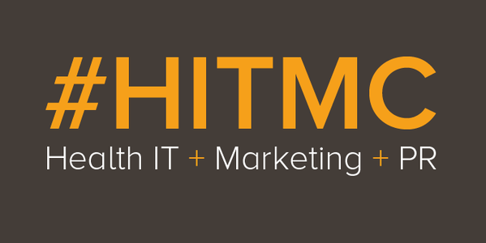
The No BS Guide to Innovation in Healthcare and when it should matter to Marketers
Inflective vs. Reflexive Innovation
Demand vs. Supply vs. Sustaining

Slide 2
This and many of my other presentations are available at
www.SpeakerDeck.com/shah
@ShahidNShah
shahid@shah.org
www.ShahidShah.com

Slide 3
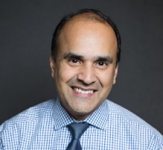
Who is Shahid?
Co-chair of the Healthcare IT Marketing & PR Conference, Co-Founder of Influential Networks and Physia
Chairman of the Board at Netspective Communications and Citus Health; Publisher at Netspective Media and serial entrepreneur.
Technology Strategist and Entrepreneur in Residence (EiR) for AHIP’s Innovation Lab https://www.ahip.org/innovationlab/
Angel investor, board member, in several digital health and Internet startups.
25 years of software engineering and multi-site healthcare system deployment experience in Fortune 50 and public sector (Fed 100 winner).
15 years of healthcare IT and medical devices experience (blog at http://healthcareguy.com)
15 years of technology management experience (government, non-profit, commercial)
Engineer, strategist, entrepreneur, investor, author, and journalist

Slide 4
What’s this talk about?
Background
Key takeaways
Everyone talks about innovation but nobody really has a definition so marketers are confused. Which means customers are confused because they get BS filled messages from marketers.
From a marketing and PR perspective, how much should you concentrate on invention, innovation, or just plain implementation?
We must seek “inflective” and not just “reflexive” innovation practices and understand that real innovators don’t speculate about the future, they work on problems that matter to their customers.
Healthcare IT marketers must develop multi-stakeholder comprehension strategies to improve value-based product designs focused on productivity improvements and cost containment.
Leverage a multi-institution approach to understand the buyer’s needs, how they are providing or paying for care, and their preferences for engagement
Discuss how to engage stakeholders across the health care industry to improve personalization and deliver the right messaging to customers at the right time

Slide 5
No, your product will not disrupt or fix the healthcare industry.

Slide 6
Why is disruption in healthcare so hard?
This is $1 Trillion and the Healthcare Market is three times this size
This is $1 Billion

Slide 7
Marketing is hard ‘cause every implementation is…
Strategy
Workforce / Culture
Process
Procedures
Technology
Interoperability
Data
Middleware
Financial
Measurements
Legal

Slide 8
Keep me honest and make it practical
Innovation Planning
Implementation Tactics
Facilitating the Business Case
Has marketing and sales figured out how customer will pay for our innovations?
Would marketing “innovation” lead to sales? How?
Are product development use cases fully aligned with marketing content?
Defining the objectives
Does marketing have Objectives and Key Results (OKRs)?
Has marketing cataloged Problems to be Solved (PTBSs)?
Has marketing cataloged Jobs to be Done (JTBD)?
Have you created journey maps across your buyers, users, and benefiters?
Reimbursement innovation?
Relationship innovation (trust/alignment)?
Cost / price transparency?
How do we identify bargaining chips for each decision-maker?
Value innovation?
Functional innovation?
What JTBDs or PTBSs are being targeted for content creation or distribution?
How do we create the business cases that implementers can take to their bosses to get funding and resources?

Slide 9
Business Case: How will your customer pay for your innovation?
If you haven’t figured it out for them, customers will not figure it out for themselves
Direct Payment
Your best option but your customer’s worst option
Very few truly new technologies can be directly paid for by providers
Direct Reimbursement
Indirect Reimbursement
Payer requirements for improved quality and efficiency are creating indirect incentives to adopt innovative solutions
Improvements in technology are outpacing payer adoption
Reimbursement will come but its time consuming and difficult
Solutions targeting new value-based reimbursement incentives are highly useful to medical providers
Second best option for you, equally good for your customer
Emerging option for you and your customer
Limited adoption of ‘traditional’ fee for service reimbursement for next generation technology
Insurers paying for tech on behalf of providers is interesting opportunity

Slide 10
Your customers have no idea what interoperability means nor do they care as much about data as you do.

Slide 11
Your customer doesn’t need another mobile app, they need UI/UX to disappear into converged workflows.

Slide 12
Your thought leadership ideas are feared by permissions-oriented institutions. They’re trying to simplify while you’re trying to differentiate.

Slide 13
Marketing will not solve the problem that your solutions can not be easily integrated into regulated device-focused clinical workflows.
Incumbent vendors will not entertain the potential of new legal liabilities without someone to share it with or new competition without direct compensation.

Slide 14
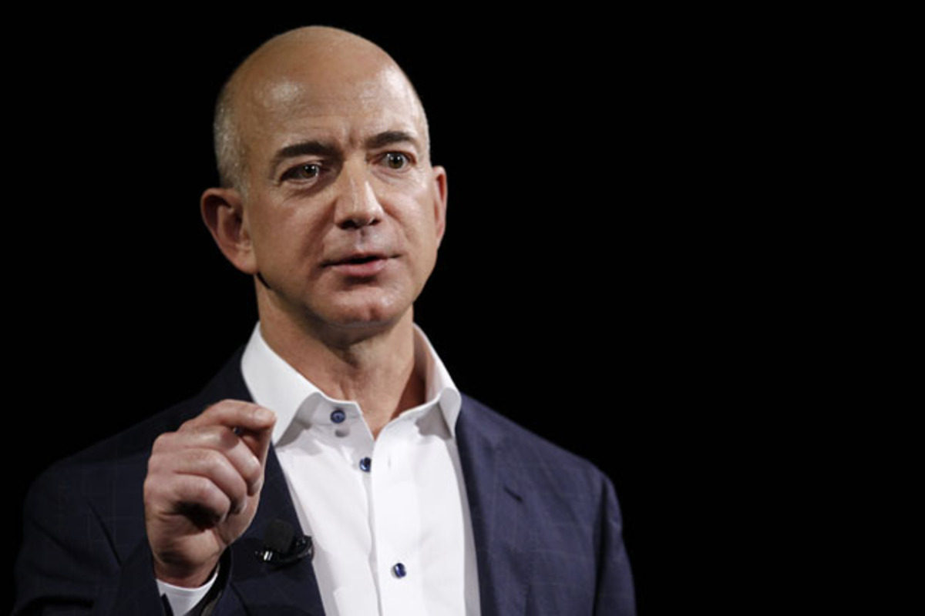
“What's not going to change in the next 10 years?”
Jeff Bezos

Slide 15
What's not going to change in healthcare?
Do no harm, safety first, and reliability effect on standard of care
Government as dominant purchaser
Eminence & consensus driven decisions as collaboration increases
Statutory cruft & regulatory burdens increase over time
Outcomes based payments intermediation & pricing pressure
Increased use of alternate sites of care
Notes:
How many of you watched House MD?
Let’s see if we can remember the things that Dr. House was always fighting.
Those are all things that won’t change anytime soon.
As leaders of patients or clinicians or anyone else in the healthcare industry if you steer clear of what’s not going to change, you’ll be able to say ‘yes’ and be more effective more often.
EXPLAIN EACH ONE.

Slide 16
Inflective vs. Reflexive Innovation
STRATEGIC
LAZY
“we need uberization of healthcare”
“would my patients pay a subscription fee for my common services?”
Doing something stupid faster is not innovation.
INFLUENCE DEMAND
“we need to disrupt healthcare”
“would up-front pricing reduce uncollectable debt?”
“we need to buy more digital health tools”
“how can we pay non-clinicians to handle more patient-facing tasks?”
Notes:
Lazy – because they care more about themselves than they care about their customers.
For example, you often hear “we need more uberization of medicine” … that’s a lazy, reflexive innovation approach because it doesn’t take into account why things are the way they are in healthcare.

Slide 17
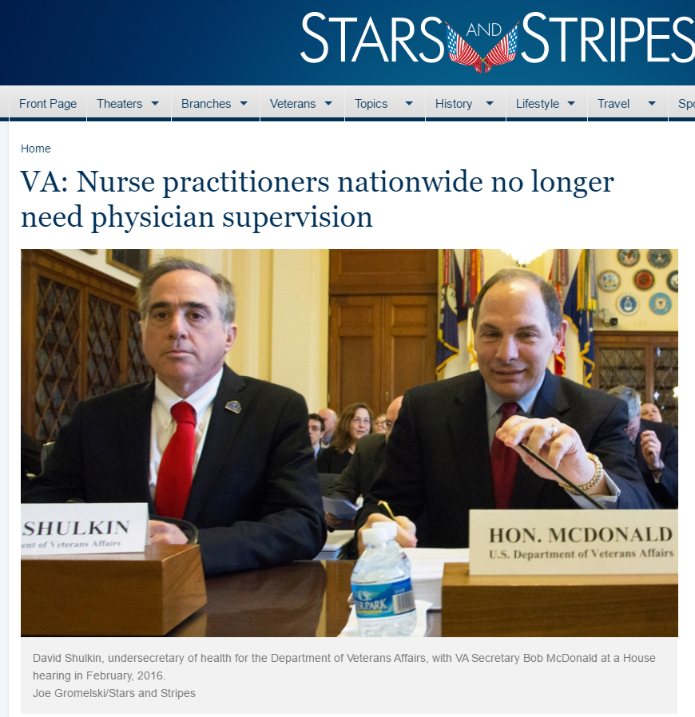
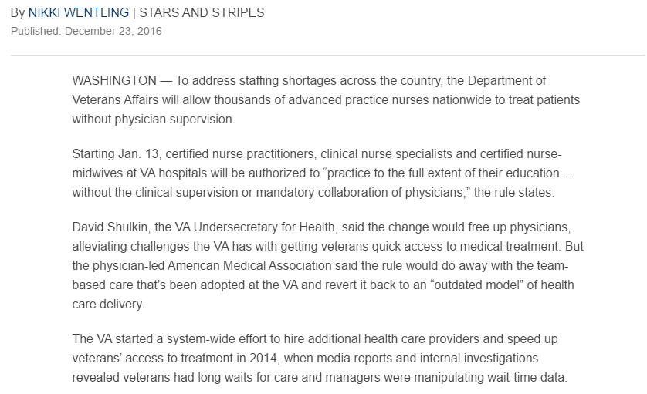
INFLECTIVE INNOVATION
http://www.stripes.com/va-nurse-practitioners-nationwide-no-longer-need-physician-supervision-1.445862

Slide 18
There is an innovation crisis in the healthcare industry because of reflexive (sustaining) innovation focus.
You cannot solve this as marketers but you can help your customers see the BS. ☺
Story Ideas

Slide 19
Industry’s fundamental unanswered questions
Why is cost per patient per procedure / treatment going up?
Why is cost for same procedure / treatment plan highly variable?
How do we compare health treatment effectiveness across patients?
Is variability in fees and treatments leading to more fraud?
How many medical errors are caused by lack of visibility of entire patient record?
How do we compare drug efficacy across patient populations?

Slide 20
What do your customers really care about?
Coordinate care for high risk patients?
Increase capacity to take care of more patients?
Keep patients from being referred outside their system?
Acquire new patients?
Increase clinician productivity?
Redesign their workforce for value based care?
Reduce care variance?
Enhance preventative services?
Reduce readmissions?
Story Ideas

Slide 21
Does marketing know its brand’s purpose?
Increase topline revenue
Maintain or enhance clinical or admin services
Protect margins
Attract new patients or retain existing ones
Increase staff productivity
What’s your reason?

Slide 22
Does marketing segment populations / services?
Prevention
Management
Well Patient
At Risk
Chronic Care
Acute Treatment
Education
Health Promotions
Healthy Lifestyle Choices
Health Risk Assessment
Obesity Management
Wellness Management
Assessment – HRA
Stratification
Dietary
Physical Activity
Physician Coordination
Social Network
Behavior Modification
Diabetes
COPD
CHF
Stratification & Enrollment
Disease Management
Care Coordination
MD Pay-for-Performance
Patient Coaching
Physicians Office
Hospital
Other sites
Pharmacology
Catastrophic Case Management
Utilization Management
Care Coordination
Co-morbidities
26 % of Population
4 % of Medical Costs
35 % of Population
22 % of Medical Costs
35 % of Population
37 % of Medical Costs
4% of Population
36 % of Medical Costs
Source: Amir Jafri, PrescribeWell

Slide 23
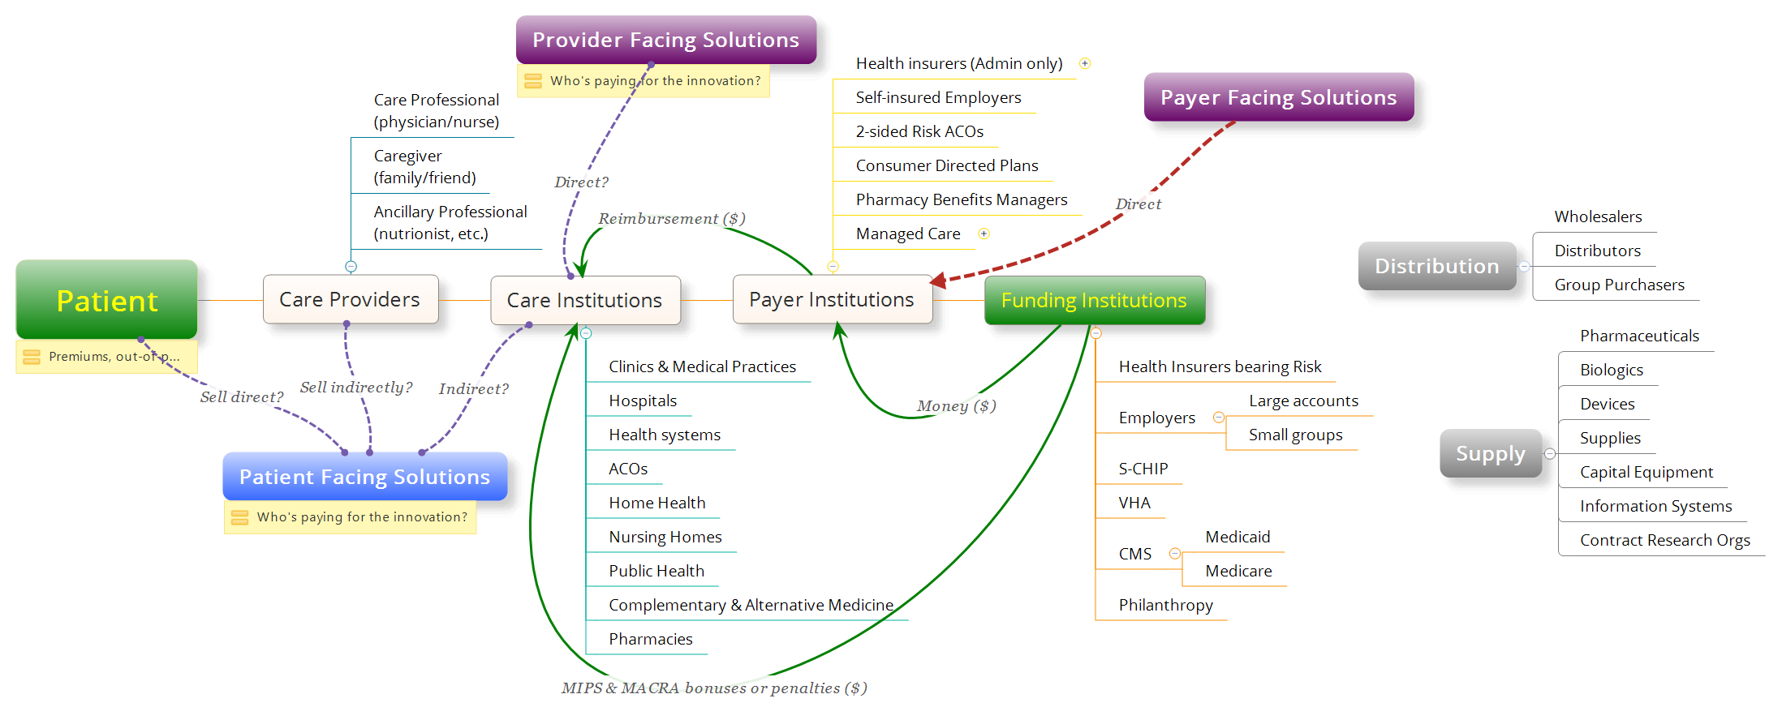
Intermediation continues to grow
Does marketing understand the fundamental intermediation in healthcare and the way money flows through the system?
Story Ideas

Slide 24
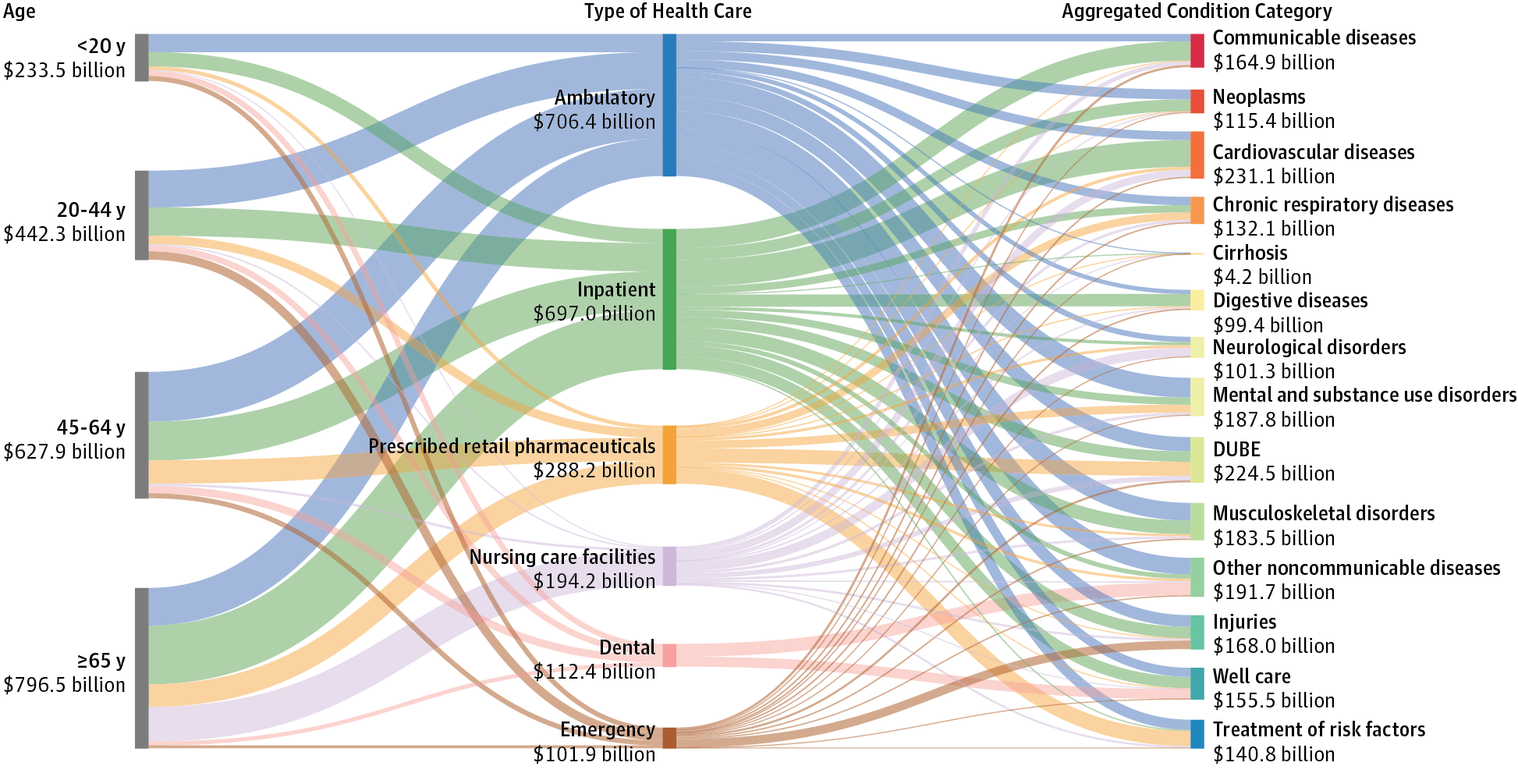
Does marketing understand that no one funding entity or insurer has beneficiary long enough to be accountable for long-term care?
http://jamanetwork.com/journals/jama/fullarticle/2594716

Slide 25
Possible solution: “collaborative engagement” (CE)
Analyze high cost, high impact targets (not necessarily by looking at demographics)
Design incentive plans for providers to participate as influencers
Design incentive plans for members to work through influencers and advocates
Activate health institutions, caregivers, and clinicians
Let influencers engage patients or caregivers by extending tools to them
Create engagement tools for health institutions, caregivers, and clinicians
Let patients engage caregivers or vice-versa through their influencers and advocates
Track outcomes and results of programs through active telemetry across the network
Story Ideas
16
Notes:
Simply having payors data does not interest consumer. It needs to be augmented with their providers data to make it meaningful to consumer
To engage patients, there need to be some clinical (health/Wellness) values. Plus consumers usually do not trust Payor for guidance. Good to have providers in the picture when interacting with health consumers (patients).
References. Impact of Patient Engagement Outcome
“Patient engagement and patient-centred care in the management of advanced chronic kidney disease and chronic kidney failure” by Robert Allan Bear and Suzanne Stockie, Canadian Journal of Kidney Health and Disease 2014, 1:24 http://www.cjkhd.org/content/1/1/24
Calculating ROI of Patient Engagement
Building Patient-Centeredness in the Real World: The Engaged Patient and the Accountable Care Organization, By Michael L. Millenson, President, Health Quality Advisors LLC
Kathleen M Schneider, Brian E O'Donnell, and Debbie Dean, “Prevalence of Multiple Chronic Conditions in the United States Medicare Population,” Health and Quality of Life Outcomes 7, no. 82 (2009). -- better communication can improve clinical outcomes in ills such as Diabetese, hypertension and cancer.
United States Renal Data System, 2014 Annual Data Report: Epidemiology of Kidney Disease in the United States. National Institutes of Health, National Institute of Diabetes and Digestive and Kidney Diseases, Bethesda, MD, 2014. http://www.usrds.org/adr.aspx

Slide 26
“My institution first” approach to patient care
Each population requires different engagement techniques at various times.
But ecosystem participants don’t work together.
Tech marketers cannot solve these problems but they can highlight inefficiencies and use them as conversation starters.
Product 1
Insurer | Payer
Product 2
Provider 1
Provider 2

Slide 27
Collaborative engagement for shared benefit
Each member population get personal care through their provider or other advocate, enabled by health insurer tools and support.
Tech marketers cannot solve this in isolation but you can start to partner for got to market strategies across the ecosystem.
Product 1
Provider 1
Insurer | Payer
Product 2
Caregiver
Provider 2
Product 3
Influencers

Slide 28
How CE can help differentiate solutions
Providers’ work
Payers’ Work
Clinical services
Patient registries
Fill gaps in care
Coding and sending claims for services
Schedule and coordinate care clinically
Engage patients during clinical services
Recruit patients
Pay claims
Identify gaps in care
Coordinate care administratively
Engage consumers pre- and post-clinical services
Risk scoring and registry identification
Identify care variability across MSMI
Understand utilization and engage network
Story Ideas

Slide 29
Can CE align multiple roles and responsibilities?
Source: Value-Based Care – What Revenue Cycle Impacts should you worry about? Marhefka, et. al.
Provider-Payer Collaboration – Shared Objectives, Blurring Roles & Vendors that Don't Get it; Janice Young Chilmark

Slide 30
Marketing opportunities in new care approaches
General Wellness
Specific Prevention
Self Service Physiologics
Self Service Monitoring
Healthcare Professional Monitoring
Self Service Diagnostics
Healthcare Professional Diagnostics
Hospital Monitoring
Hospital Diagnostics
Care Team Monitoring
Care Team Diagnostics

Slide 31
Should marketing teams help move from reflexive to inflective innovation?
Do customers care about what you think is innovation or will they care more about you when you care about what their innovation needs are?
Is the marketing workforce ready?

Slide 32
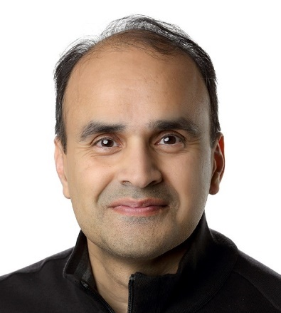
Visit http://www.netspective.com http://www.healthcareguy.com E-mail shahid.shah@netspective.com Follow @ShahidNShah Call 202-713-5409
Thank You!
This deck is available at http://www.speakerdeck.com/shah
Need help with your innovation?
Tweet, call or write to me.

